Slide 1
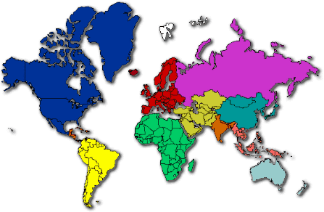
Christmas Around the World

Slide 2
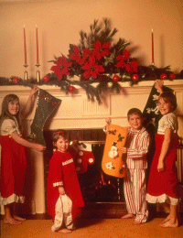
Christmas Around the World
It is interesting to see how different countries celebrate Christmas.
The USA is so multi-cultural that you will find many different ways
of celebrating Christmas. How is Christmas celebrated around the
world?

Slide 3
Germany

Slide 4
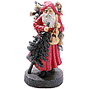
Germany
Germans love to decorate their houses at Christmas. Many houses will
have little wooden frames holding electric candles in their windows,
and coloured pictures of paper or plastic which look beautiful from
the outside at night. Often too, they will have an 'Adventskranz' –
a wreath of leaves with four candles. (Advent - meaning 'coming' –
is the 4 week period before Christmas). On each Sunday of Advent,
Another candle is lit. Most homes will also have little wooden
'cribs' - a small model of the stable where Jesus was born, with Mary,
Joseph, Baby Jesus, and animals. Children leave letters on their window
sills for Christkind, a winged figure dressed in white robes and a
golden crown who distributes gifts. Father Christmas –
'Der Weihnachtsmann' - brings presents in the late afternoon of
Christmas Eve (December 24th), after people have been to a church
meeting. The presents are then found under the Christmas tree. One
person in the family will ring a bell and call everyone to come to the
room. “Froehliche Weihnachten” “Merry Christmas!”

Slide 5
Belgium

Slide 6
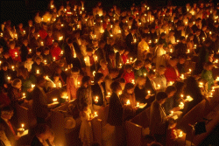
Belgium
In the days of the Soviet Union, Christmas was not
celebrated very much. New Year was the important
time - when 'Father Frost' brought presents to children.
With the fall of Communism, Christmas can be openly
celebrated - either on December 25th; or more often on
January 7th. This unusual date is because the Russian
Orthodox church uses the old 'Julian' calendar for
religious celebration days. Special Christmas food
includes cakes, pies and 'meat dumplings'.

Slide 7
Australia

Slide 8
Australia
Christmas over here in Australia seems to be more casual than
anywhere else, from all the reports I've heard. We'll have breakfast
with our immediate families, first, if we're staying at our own house
or a hotel. It's normally bacon, eggs, toast, and black pudding (Yum!).
Then, at about 11 am, we go to a relative's house or they come to
ours - normally we swap each Christmas. We open some presents,
And have our lunch, which would be prawns, and crab, things like
that. After lunch, we open more presents, and explore them! Then,
the 'over 30s' have a nap, while we younger ones give each other
little presents, normally not more than five to ten dollars each.
Then, we have a swim if there's a pool anywhere nearby, but if there
isn't, we go to a park, or something like that. We have our main meal at
dinner time. Turkey, chicken, fish, crab, prawns, potato, pumpkin, peas,
pudding -the works and reminisce over the year. Then we sleep.
And that's all Christmas is over here.

Slide 9
Italy

Slide 10
Italy
In Italy Christmas begins on 1st of December. We decorate the
tree, or, more often, we make the "PRESEPE". The Presepe is a sort of
Little miniature of what happened on December 25th of the year 0 B.C.
We put a big hut with Mary, Joseph, Jesus, a donkey and a bow. It's said
that Jesus was warmth during the first night by the two animals. In the
presepe there's not only the holy family, we put also the three kings,
shepards, with sheep of course, fishermen, curious people some angels,
houses, lights and animals. Presents are usually put under, or in any case
as near as possible to the presepe. On Dec. 25th's night presents are
taken out of the wardrobe. We believe that Jesus Christ in person comes
to bring the presents. Christmas dinner is served on the night of December
24th, while others take it on midday of 25th. We give our presents
before the meal begins. Everyone has to have a present. We light up
the mantelpiece and teenagers enjoy themselves with little firecrackers.
This is our usual Christmas and the presepe is put away only on
January 7th. “Buone Feste Natalizie” “Merry Christmas!”

Slide 11
Mexico

Slide 12
Mexico
Christmas festivities begin with "Las Posadas," nine
consecutive days of candelight processions and lively parties starting
December 16. In villages and urban neighborhoods throughout
Mexico youngsters gather each afternoon to reenact the holy family's
quest for lodging in Bethlehem. The parade of "Santos Peregrinos"
(Holy Pilgrims) stops at a designated house to sing a traditional litany
by which the Holy Family requests shelter for the night and those
waiting behind the closed door turn them away. They proceed to a
second home where the scene is repeated. At the third stop the pilgrims
are told that while there is no room in the "posada" (inn), they are
welcome to take refuge in the stable. The doors are flung open and
all are invited to enter.
“¡Feliz Navidad!” “Merry Christmas!”

Slide 13
England

Slide 14
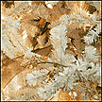
England
For English children, Christmas begins in October when most English children write their Christmas Lists to Father Christmas. English houses are decorated two weeks before Christmas day. The tree is decorated with tinsel, twinkling fairy lights, tartan ribbons and baubels. The home is usually decorated with statues of Father Christmas, holly wreaths, mistletoe, and welcoming lights at the windows. English children go to bed on Christmas Eve night after having 'The Night Before Christmas' read to them by their parents and leaving a mince pie and some milk for Father Christmas (and a carrot for Rudolph).
On Christmas Day morning they rush into their parents bedrooms and drag their parents downstairs to the living room where a stack of Christmas presents lie under the tree, in stockings or in sacks.
The tree and decorations are unwillingly taken down two weeks after Christmas day, as it is considered bad luck if they are up longer.
“Merry Christmas!”

Slide 15
Norway

Slide 16
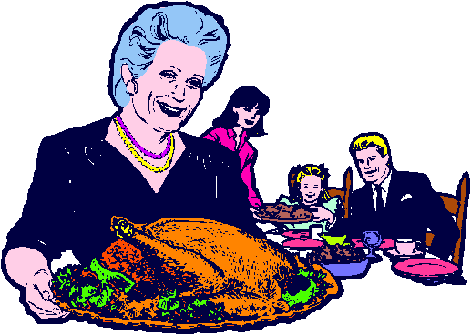
Norway
In big Norwegian country kitchens in farms and villages off the beaten track the hectic preparations still begin weeks before the festival season. The smell of Christmas fills the house, bringing the children's
expectations up to fever pitch. But the children do not usually enjoy the meal very much. Their eyes keep turning to the closed living room door, and they grow more and more impatient with the unbearably slow pace with which their elders finish the meal. The children tumble in as the door is opened, only to stop short, awestruck by the sight of the tree, aglow with the light from real candles, and with the neatly wrapped gifts heaped underneath. Then follows a Norwegian ritual known as "circling the Christmas tree". Everybody joins hands to form a ring around the tree, and the company then walk around it singing carols. Finally, the gifts are distributed, and the children can relax. The rest of the evening is spent on fun and games and there are cakes and other good things to be eaten. On the morning of Christmas Day itself the family goes to church. “God Jul” “Merry Christmas!”

Slide 17
France

Slide 18
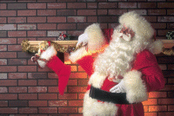
France
In France, Christmas is always called 'Noël. Everyone
has a Christmas tree, sometimes decorated in the old
way with red ribbons and real white wax candles. Fir
trees in the garden are often decorated too, with lights
on all night. Father Christmas is called Père Noël. The
Christmas meal is an important family gathering with good meat
and the best wine. Not everyone sends Christmas cards.
“Joyeux Noel”
“Merry Christmas!”

Slide 19
Brazil

Slide 20
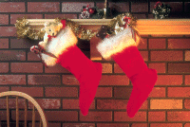
Brazil
Father Christmas is called Papai Noel. Many Christmas
customs are similar to USA or UK. For those who have
enough money, a special Christmas meal will be chicken,
turkey, ham, rice, salad, pork, fresh and dried fruits. Poorer
people will just have chicken and rice.
“Boas Festas e Feliz Ano Novo”
“Merry Christmas!”

Slide 21
Finland

Slide 22
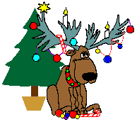
Finland
Finnish people believe that Father Christmas (Santa Claus) lives in the
north part of Finland called Korvatunturi, north of the Arctic Circle.
People from all over the world send letters to Santa Claus in Finland.
(It is only fair to say that the people of Greenland say that really, Father
Christmas lives in Greenland!) Everyone cleans their houses ready
for the three holy days of Christmas - Christmas Eve, Christmas Day, and
Boxing Day. Christmas Eve is very special, when people eat rice porridge
and plum fruit juice in the morning. They will then decorate a spruce tree
in the home. At mid-day, the 'peace of Christmas' is broadcast on radio
And TV from the Finnish city of Turku by its Mayor. In the evening, a
traditional Christmas dinner is eaten. Many families will visit cemeteries
and grave-yards to place a candle onto the burial graves of family
members. Cemeteries are very beautiful at Christmas-time. Children
receive their presents on Christmas Eve, usually with a family member
dressing as Father Christmas. “Hyvaa joulua” “Merry Christmas!”

Slide 23
Portugal

Slide 24
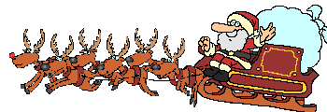
Portugal
People pretend that Father Christmas brings presents to
children on Christmas Eve. The presents are left under
the Christmas tree or in shoes by the fireplace. A
special Christmas meal of salted dry cod-fish with
boiled potatoes is eaten at midnight on Christmas Eve.
“Feliz Natal”
“Merry Christmas!”

Slide 25
Russia

Slide 26
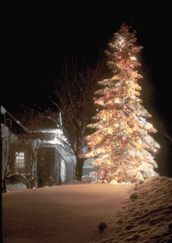
Russia
In the days of the Soviet Union, Christmas was not
celebrated very much. New Year was the important
time - when 'Father Frost' brought presents to children.
With the fall of Communism, Christmas can be openly
celebrated - either on December 25th; or more often on
January 7th. This unusual date is because the Russian
Orthodox church uses the old 'Julian'
calendar for religious celebration days.
Special Christmas food
includes cakes, pies and
'meat dumplings'.
“Pozdrevlyayu s prazdnikom
Rozhdestva is Novim Godom”
“Happy Birthday Jesus!”

Slide 27
China

Slide 28
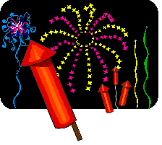
China
Christians in China celebrate by lighting their houses with
beautiful paper lanterns and decorating their Christmas trees,
which they call "Trees of Light," with paper chains, paper flowers,
and paper lanterns. Chinese Children hang muslin stockings and
await a visit from Santa Claus, whom they call Dun Che Lao Ren
(dwyn-chuh-lau-oh-run) which means "Christmas Old Man.".
Since the vast majority of the Chinese people are not Christian, the
main winter festival in China the Chinese New Year which takes
place toward the end of January. Now officially called the "Spring
Festival," it is a time when children receive new clothing, eat
Luxurious meals, receive new toys, and enjoy firecracker displays.
An important aspect of the New Year celebration is the worship of
ancestors. Portraits and paintings of ancestors are brought out and
hung in the main room of the home.

Slide 29
Japan

Slide 30
Japan
Christmas was introduced in Japan by the Christian missionaries,
and for many years the only people who celebrated it were those
who had turned to the Christian faith. But now the Christmas season
in Japan is full of meaning and is almost universally observed. The
idea of exchanging gifts seems to appeal strongly to the Japanese
people. The tradesmen have commercialized Christmas just as our
western shops have done. For several weeks before the day, the stores
shout Christmas. There are decorations and wonderful displays
of appropriate gifts for men, women, and children -- especially children.
In Japan there is a god or priest known as Hoteiosho, who closely
resembles our Santa Claus. He is always pictured as a kind old man
carrying a huge pack. He is thought to have eyes in the back of his head.
It is well for the children to be good when this all-seeing gentleman is
abroad.

Slide 31
For more Christmas celebrations
around the world, visit Christmas
Worldview, Christmas
Celebrations
Around the World, and Christmas
Traditions Around the World.

