Slide 1
Tips and Tricks to Maximize Your Fastweb Experience

Slide 2
Why Fastweb?
Access to the most scholarships you’ll find online,
with over 1.5 million scholarships worth over $3.4
billion!
Daily alerts when new scholarships that match your
unique profile become available and deadline
reminders
Insider advice from some of the leading experts in
financial aid, scholarships and college admissions
Students receive a customized experience and tools to
stay organized.
It’s all 100% FREE!

Slide 3
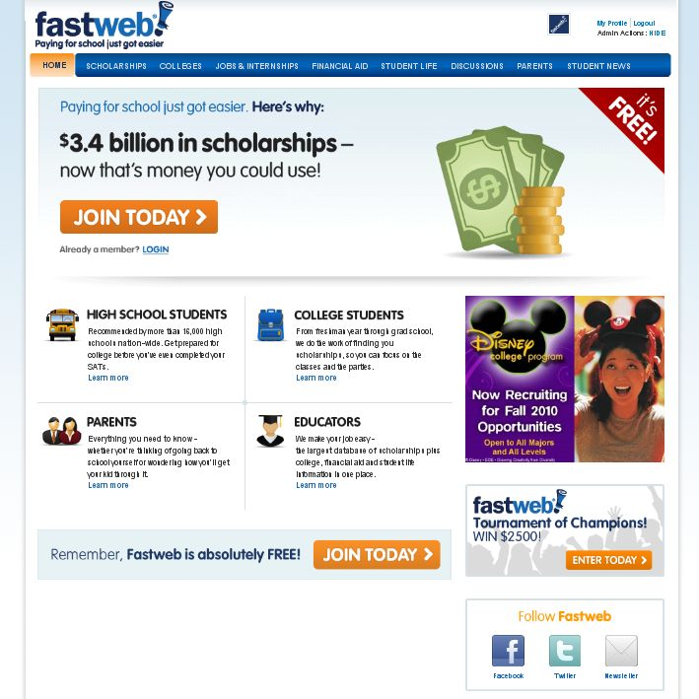
Fastweb Homepage
Start Your Scholarship Search Here!
Start Your Scholarship Search Here!

Slide 4
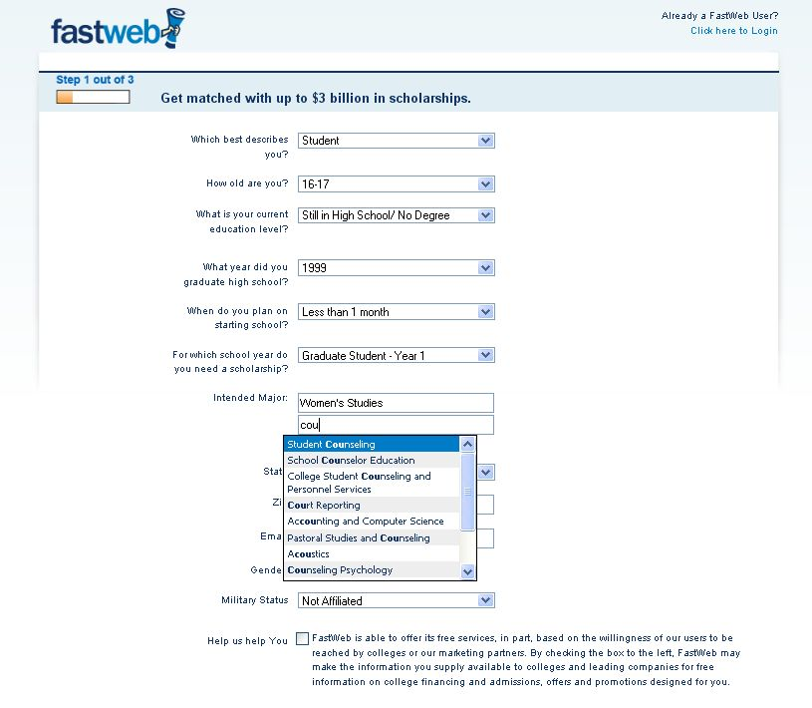
Registration Step 1
To complete the first step in your search for scholarships, answer a few questions about who you are.
Use the drop down box to select your major or intended academic major and don’t worry if you’re not sure, you can add as many as you like!
Complete all the questions, scroll down and click continue! Remember to save work frequently.

Slide 5
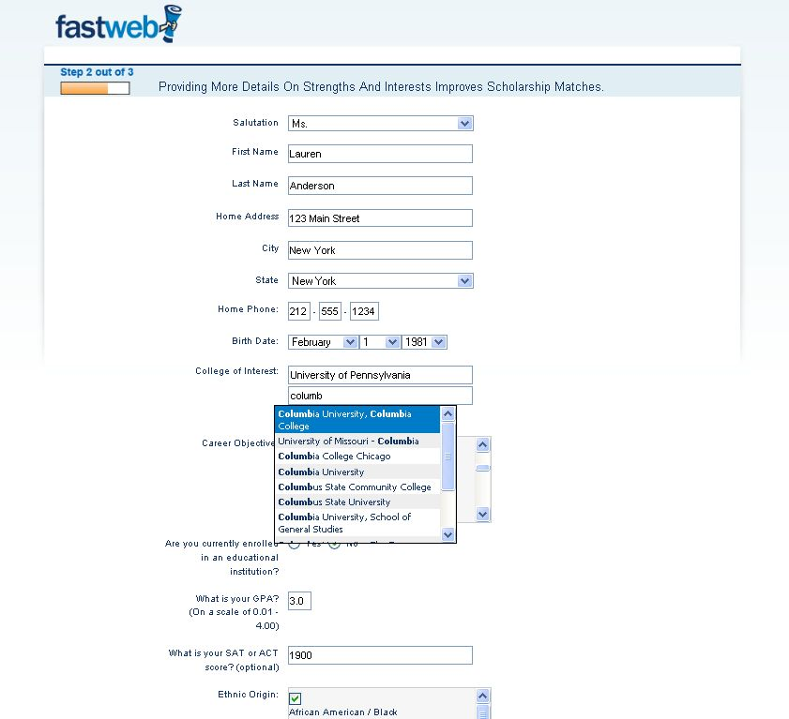
Registration Step 2
Complete all of the questions in Step 2.
You’re almost done!
Use the drop down boxes again to select your intended schools.

Slide 6
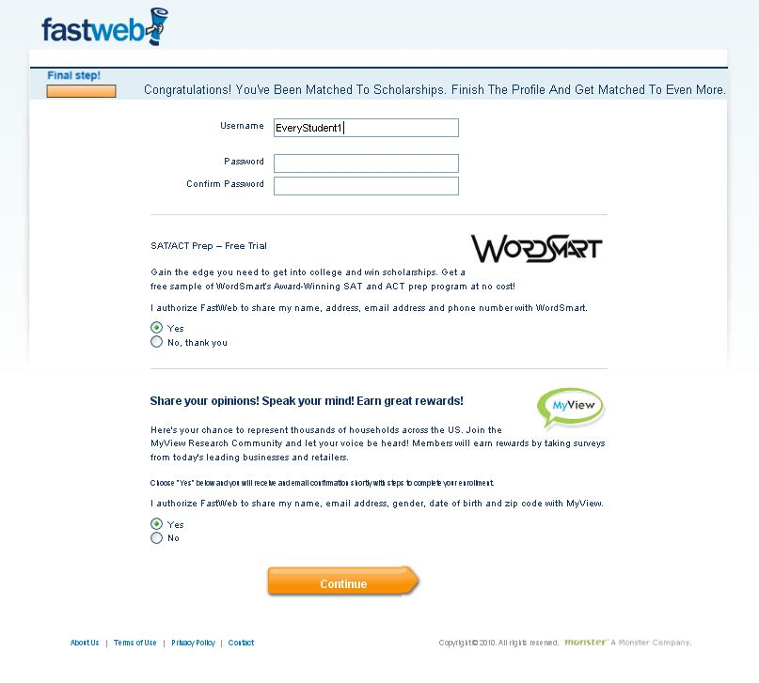
Registration Step 3
Congratulations!
Your registration is complete…but don’t go just yet.
Start by gaining access to awards others won’t see by logging in and updating your Fastweb profile with more detailed information.
Insider Tip!
Update your profile any time you have changes or additions to get the best, most relevant awards . If you don’t, you could be missing out on money for college.

Slide 7
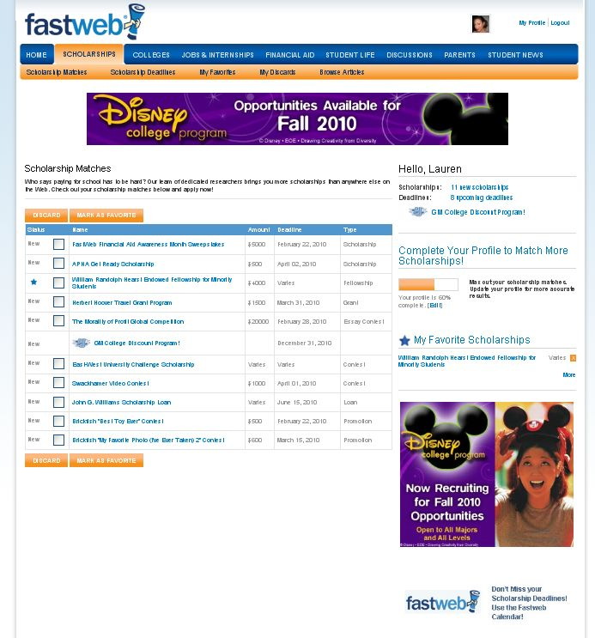
Scholarship Matches
New Scholarships and Upcoming Deadlines
Scholarship Matches and Brief Descriptions
Profile Progress Bar. Complete it and update regularly!
Insider Tip!
You can get rid of awards you don’t like, or mark them as a “favorite” to save them and find quickly later! Just check any box and then click the appropriate button.
Your “Favorites”
Access Your Personalized Calendar

Slide 8
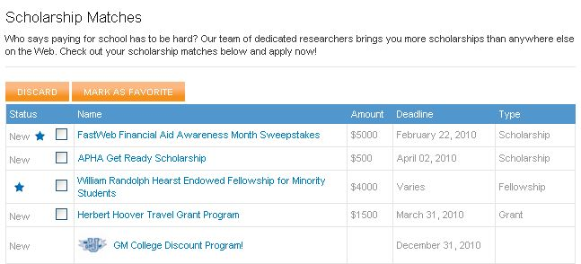
Manage Your Results
Sort results by any column heading to help manage results.
Click any scholarship to view the details, including the award description, Web site and more!

Slide 9
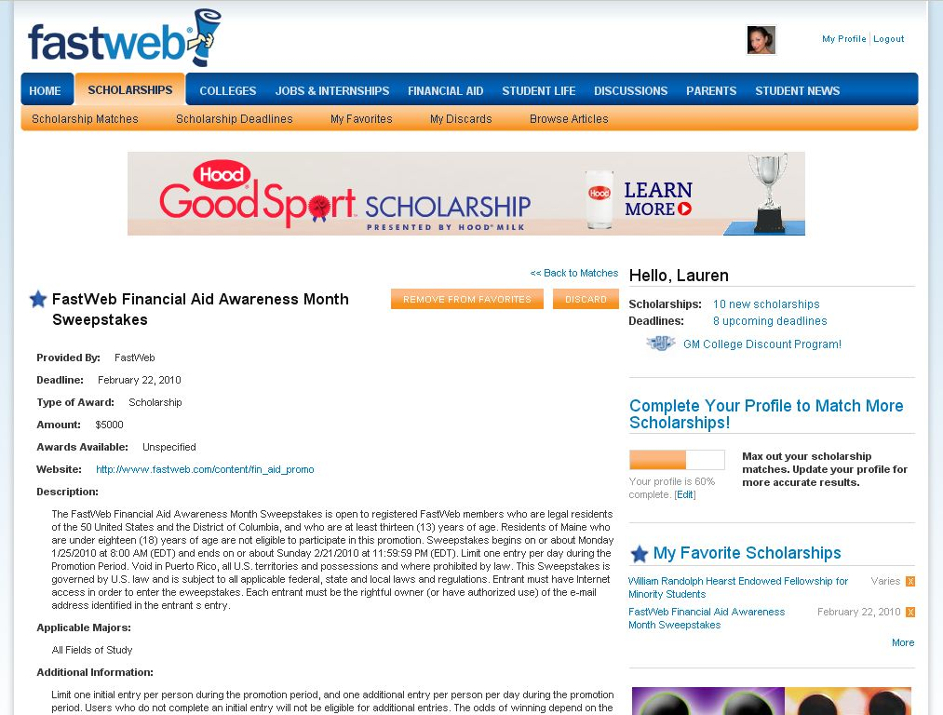
Scholarship Detail
Detailed descriptions of scholarships, include the deadline, amount, number of awards, Web site, applicable majors and more.
Add to your “Favorites” or discard from within the scholarship detail page.

Slide 10
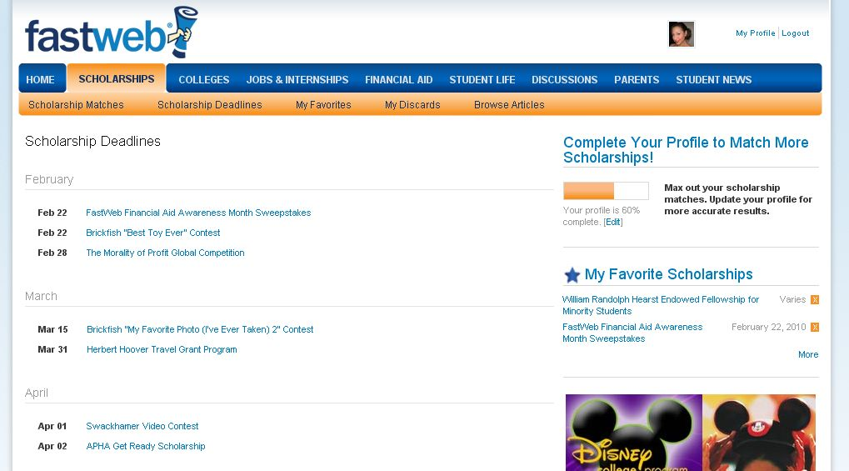
Scholarship Deadlines
Insider Tip!
Never miss a deadline again! All your deadlines are stored in your calendar!

Slide 11
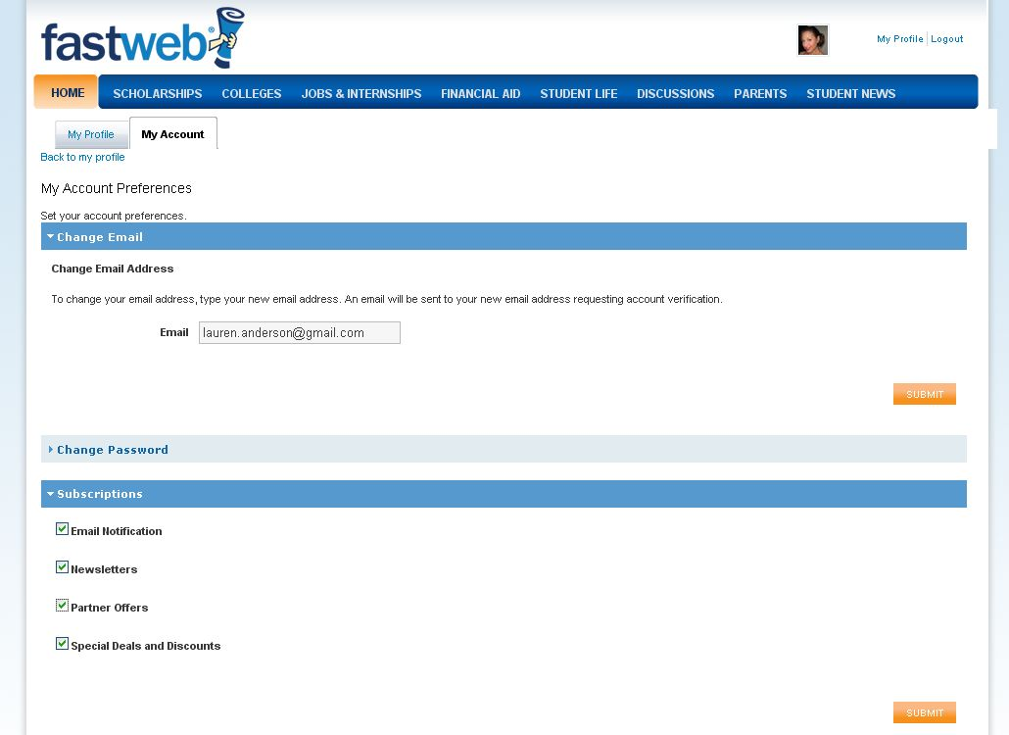
Notifications
Step 1: click “My Profile”
Step 2: click “My Account”
Insider Tip!
Get the latest news, insider advice, notifications as soon as new awards that match your profile become available and deadline notifications sent straight to your email inbox!
Step 3:
click “Subscriptions” then check the boxes for the notifications you’d like to receive and click “Submit”

Slide 12
New Scholarships
Fastweb adds new scholarships to our database daily as they become available.
When a scholarship is made available that matches your Fastweb profile information, it is immediately added to your scholarship matches.
View your new matches by logging in to Fastweb and viewing your “Scholarship Matches” from within the Scholarships section.
Fastweb can send alerts straight to your personal email account! Alerts let you know when a new scholarship has been added, or when a deadline is nearing.
REMEMBER: The more of your Fastweb profile information that you complete, the more scholarships you’ll see!
How to Take Advantage
of New Scholarships!

Slide 13
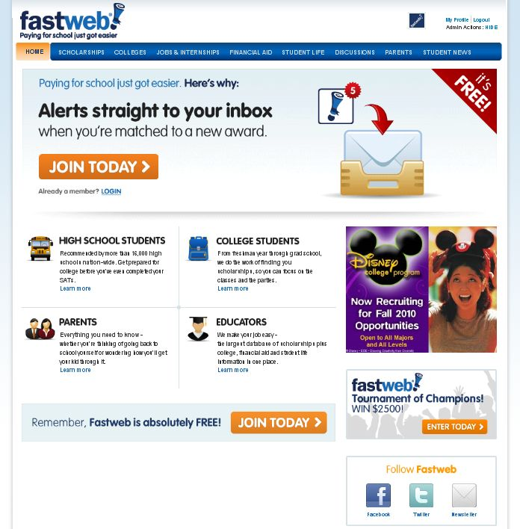
Contests
Insider Tip!
Did you know that Fastweb often gives out scholarships of its own? Get in on these fun, fast and easy chances to win more cash for college!
Check for new contests from Fastweb’s
Homepage!

Slide 14
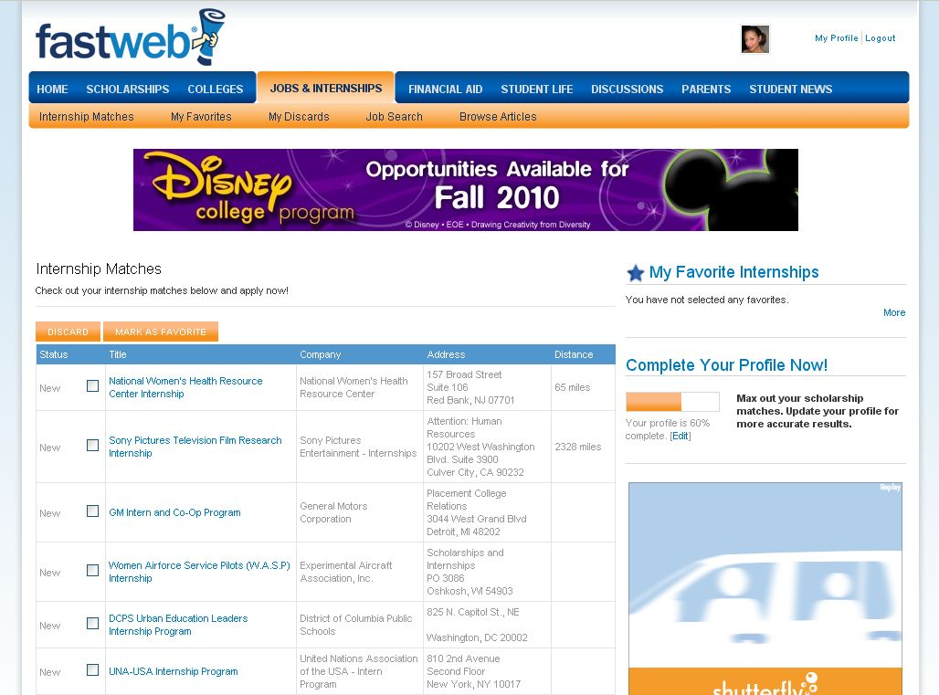
Internships
Note:
Internships are based on student’s academic major and interest, not location.
Use Fastweb to find Internships and Fellowships too! Get to Jobs & Internships from the tabs at the top of the screen.
Organize your internship matches in the same way you do your scholarship matches! Sort by column heading, or choose to discard, save to “favorites” or click to get more info.

Slide 15
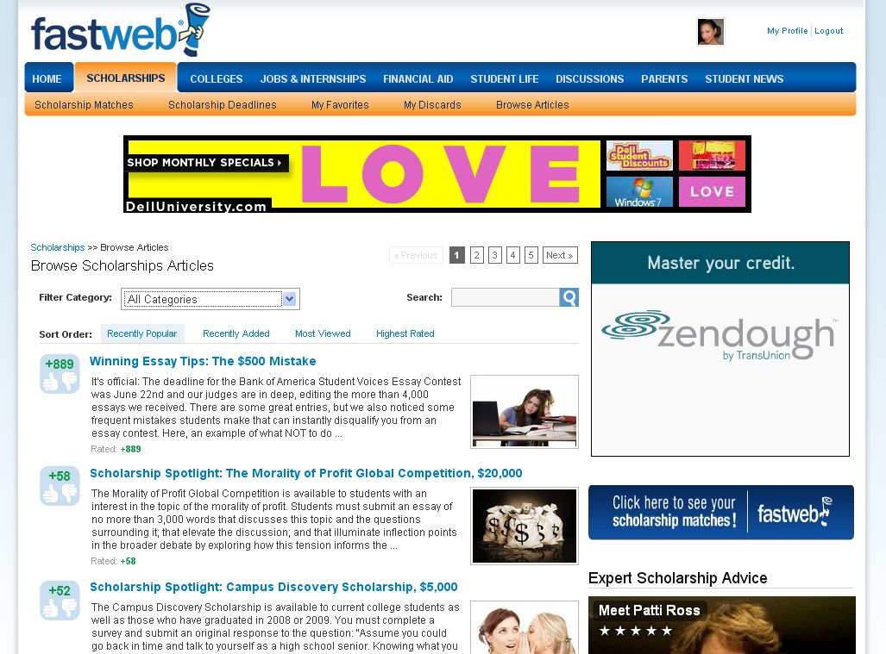
And That’s Not All
We’re More than Scholarships!
Check out all Fastweb has to offer. Navigate the site from the tabs at the top of your screen. You’ll find:
Valuable expert advice on
everything from financial
aid to college admissions
Discussion and message
boards
Breaking student news
Articles and other valuable
information
Virtual campus tours
Fastweb contests worth
money for college
Internship matches
Loan calculators
Secrets from scholarship
judges
More…

Slide 16
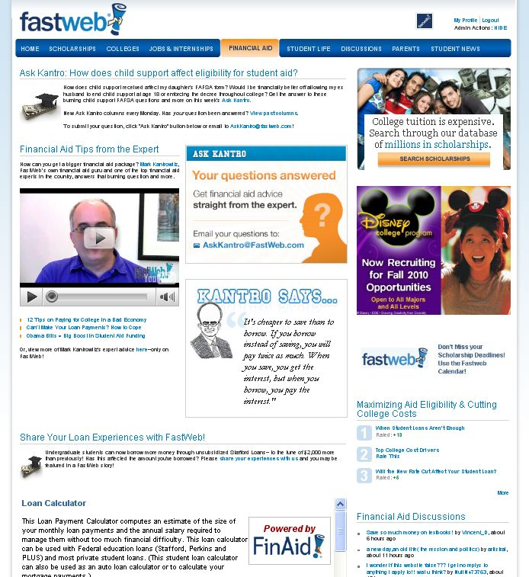
“Kantro” The Financial Aid Expert
Get your financial aid questions answered directly by the expert! Submit your questions to “Ask Kantro”.
Our nationally renowned Financial Aid Expert, Mark Kantrowitz, shares his insight with you on college financing, from completing the FAFSA to simple tips and tricks.
Wondering how much is too much when it comes to student loans? Use our student loan calculator to figure how much you can afford to borrow.

Slide 17
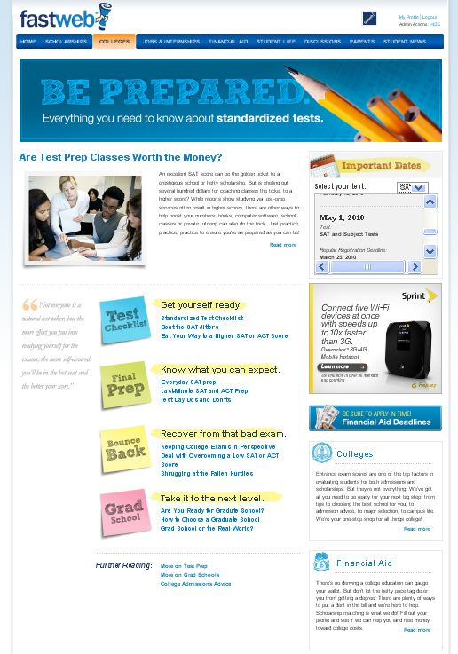
Prepare for Standardized Exams
Test Dates, including registration and late registration deadlines for all of the major exams– undergraduate and graduate.
Are test prep classes worth the money? Check with Fastweb first!
Guidance on preparing for the big exam and advice on improving your score if need be.
A complete list of financial aid deadlines state-by-state.

Slide 18
Don’t Forget!
Good Luck!
Maximize Matches
Complete all the questions on the search.
Review all possible answers for each question.
Check your current information
Ensure your results match you. If they don’t, update your Fastweb profile information.
Have you changed majors or intended school?
Is your current year in school updated?
Update, update, update and you’ll continue to get the best results!
Any Questions?
If you need help, you can reach the Fastweb team by emailing info@fastweb.com!

