Slide 1
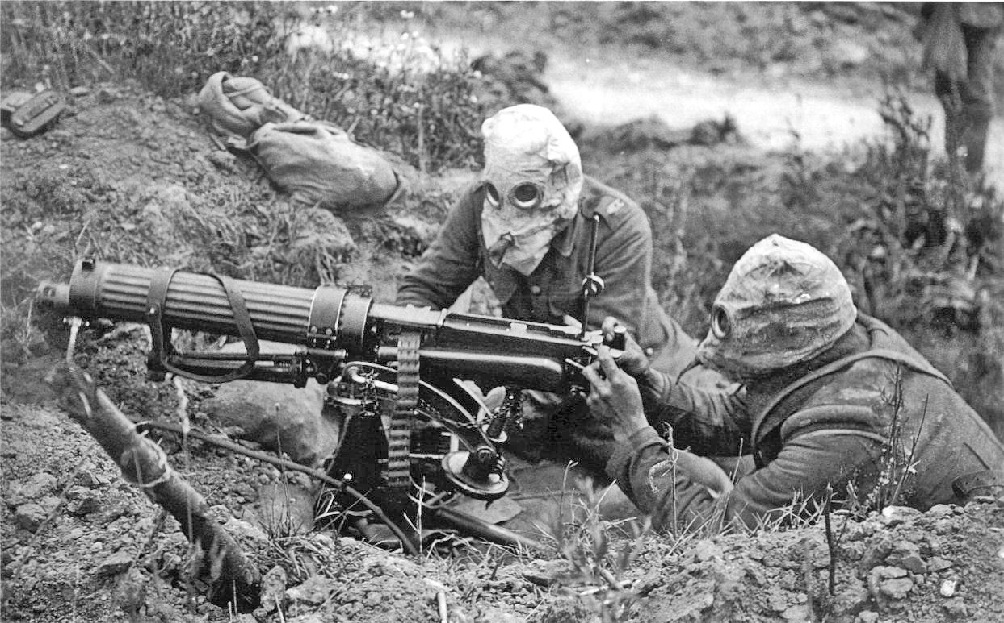
THE GREAT WAR
Industrial Technology Meets Man on the battlefield

Slide 2
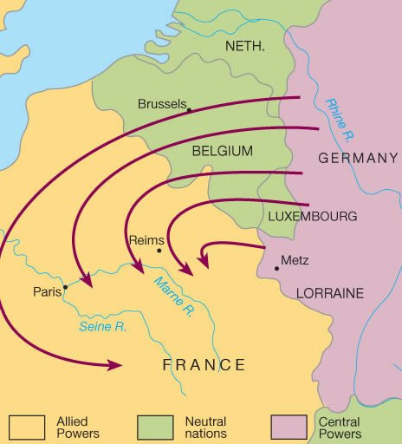
Germany Initiates war
Unleashes antiquated Schlieffen Plan
Take Paris – then ship troops to Russia before they can mobilize
Both French and Russian Militaries improved since plan was made
Belgian Neutrality Guaranteed by Britain
Germany attacks anyway – July 28
Notes:
SAS 193 PG
Schlieffen Plan did not take into consideration the improvements to both French and Russian Military and infrastructure

Slide 3
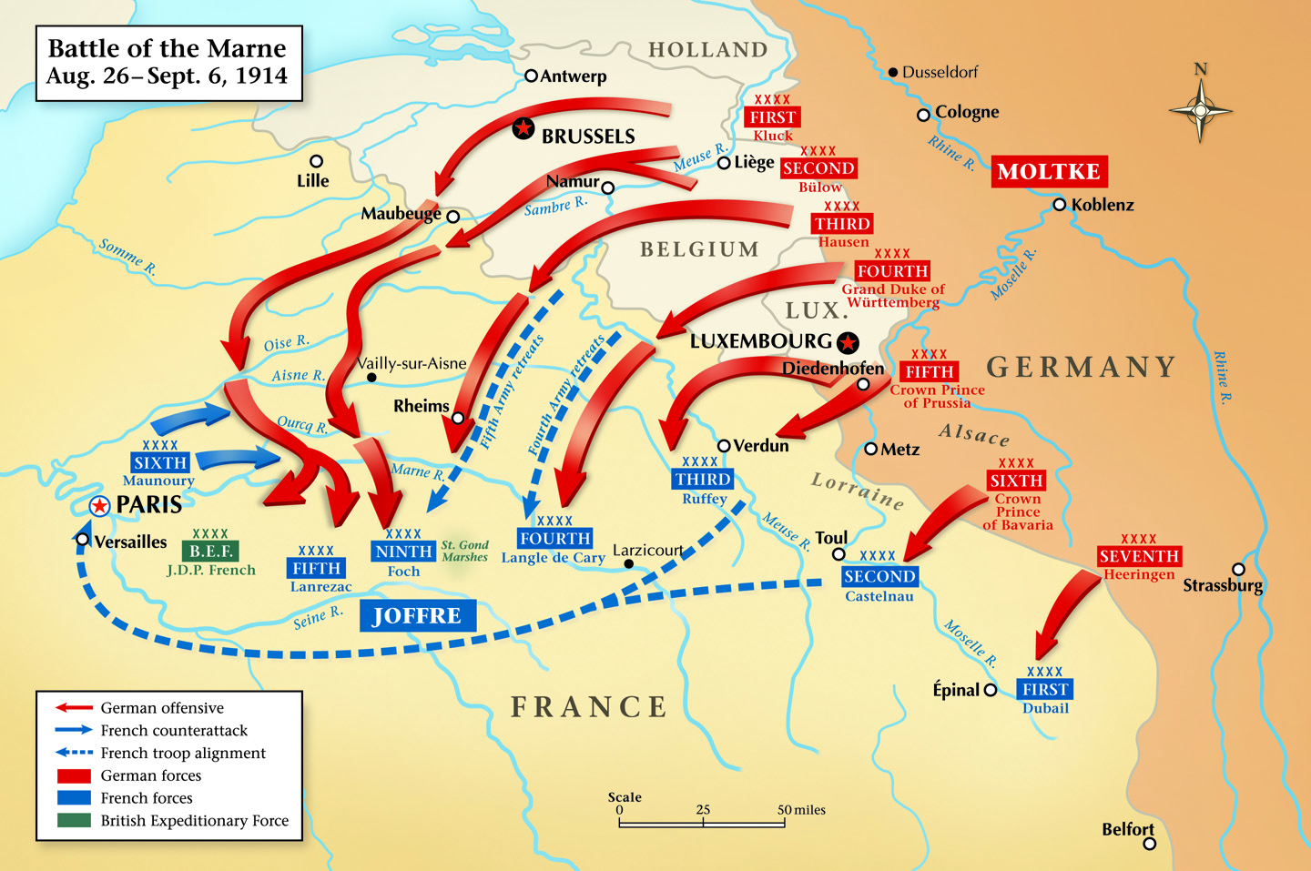
German offensive almost successful
French military stops German advance
Russia quickly mobilizes in East
Britain joins war against Germany on August 4
Germany stuck with 2 Front war
War in West quickly turns to stalemate – Trench Warfare

Slide 4
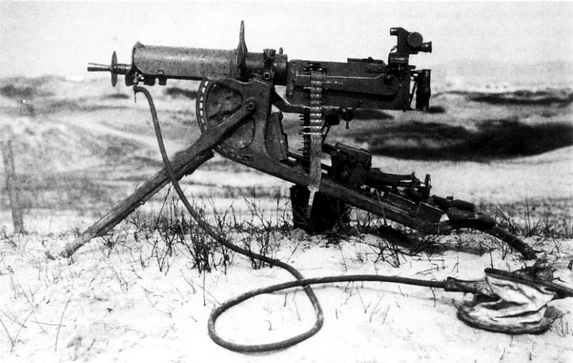
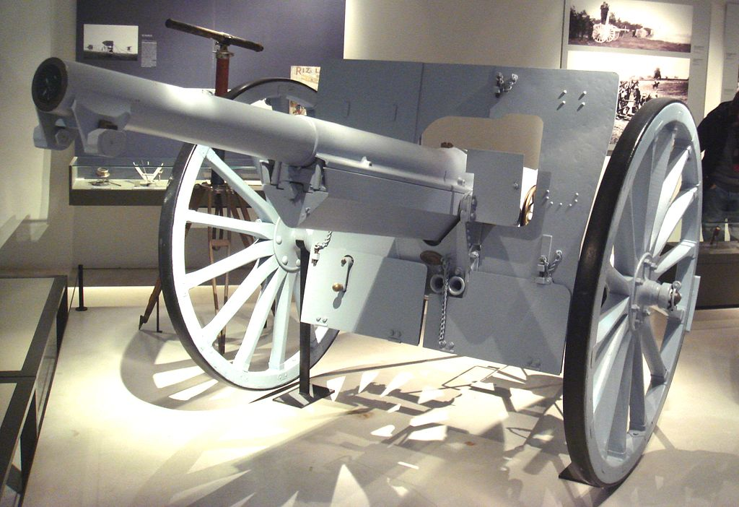
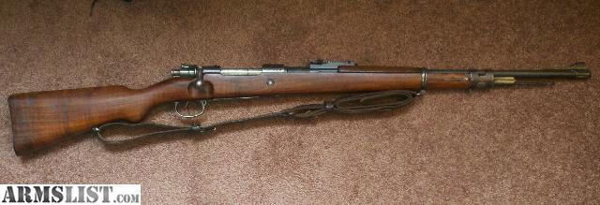
Trench Warfare
Modern weaponry makes massed assault too costly
Machine Guns, Artillery – even bolt action rifles necessitates cover, or trenches
Model 1897 Artillery
Breech load
75 mm caliber
Highly accurate
03 Springfield
Bolt Action
Effective Range = 600yds
Gewher 98 Mauser
Bolt Action
Maxim Machine Gun
Liquid Cooled
600 Rounds/Minute

Slide 5
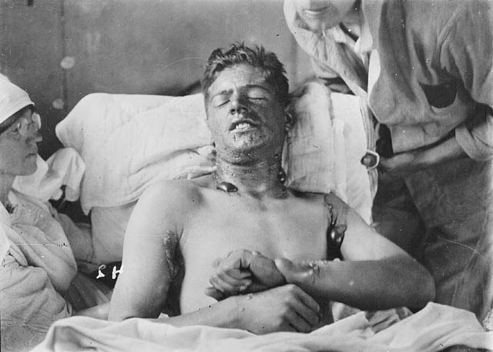
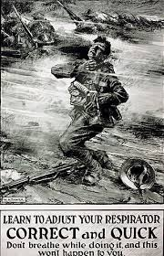
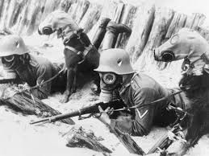
Gas/Chemical Warfare
mustard gas was extremely painful, and caused blistering, vomiting, and possibly internal bleeding.
Chlorine gas appeared as a slow-moving yellow green cloud. It was a pulmonary irritant, and acutely affected the upper and lower respiratory tracts.
Phosgene gas was deadlier than Chlorine gas, and it's symptoms sometimes took up to 48 hours to manifest. It caused suffocation

Slide 6
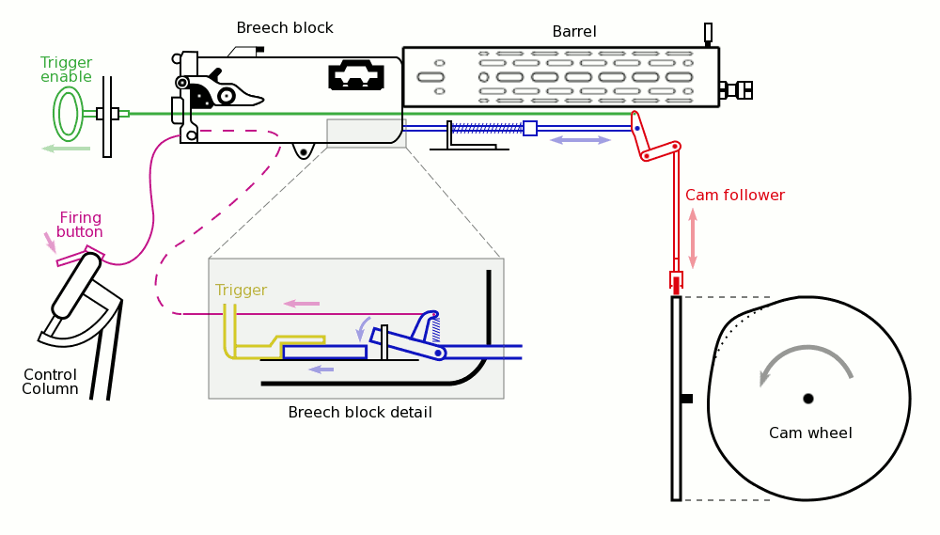
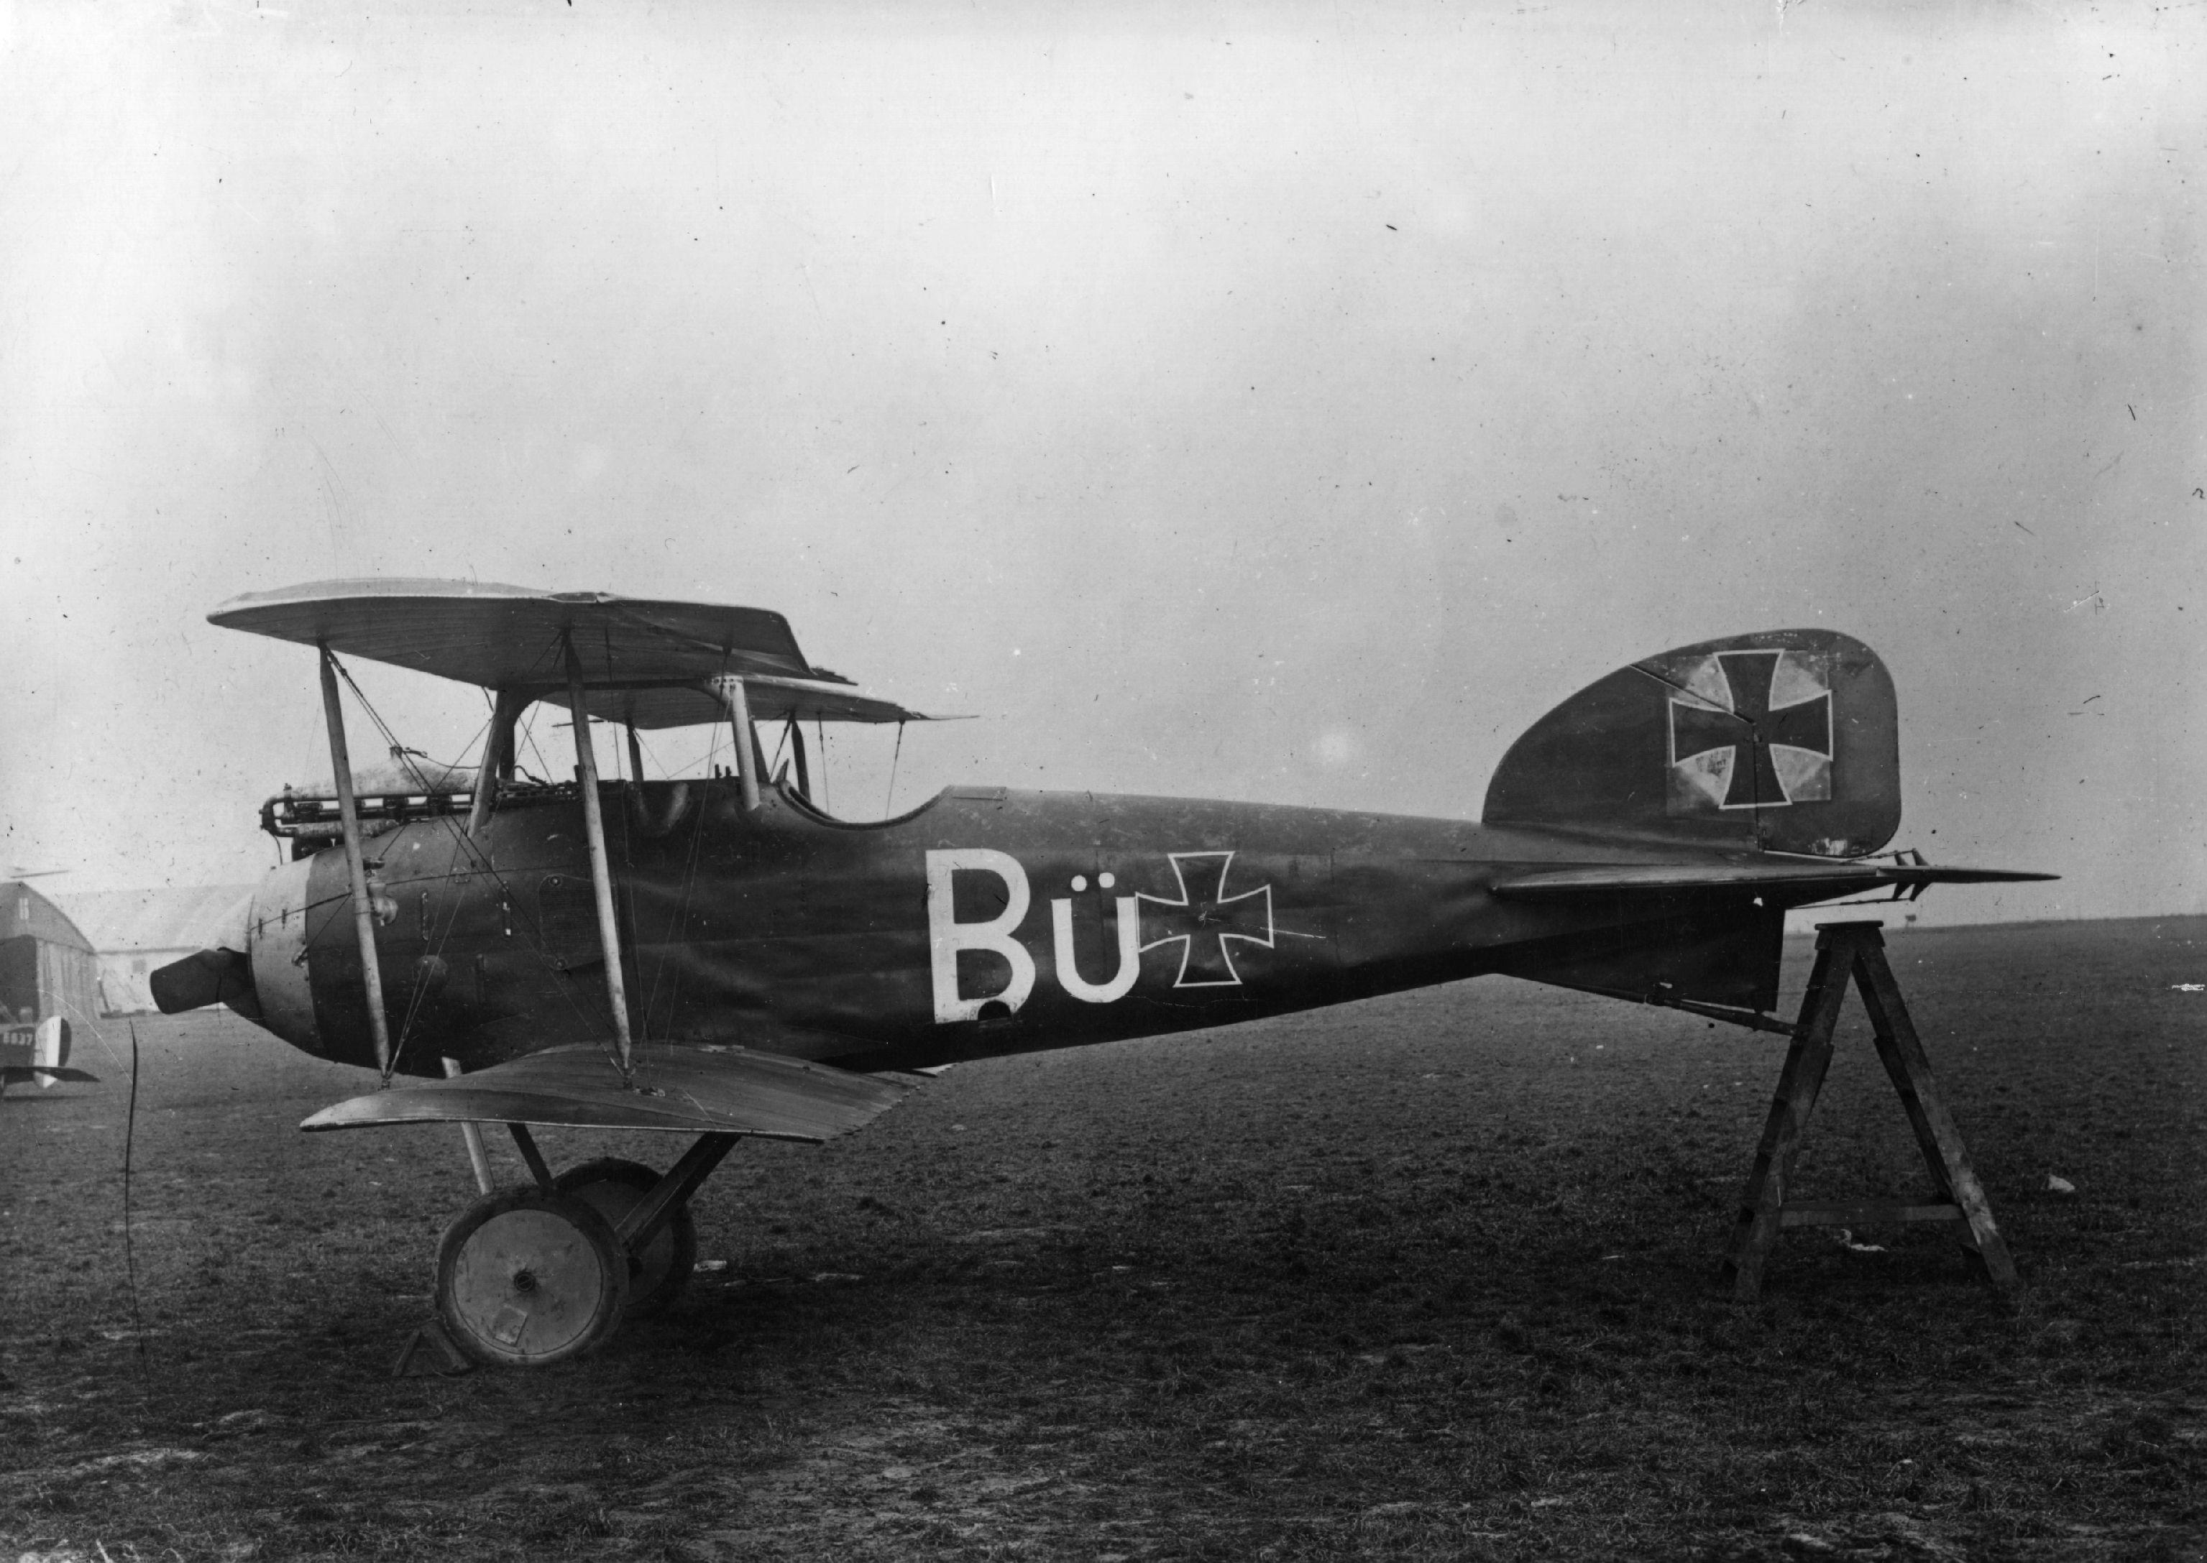
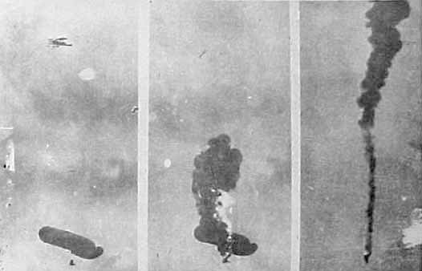
Beginnings of Military aviation
Initially used for Reconnaissance
Adapted first for personal weapons
Later armed
Fighters
Bombers
Reconnaissance
Zeppelins and Balloons also used
Notes:
Cam driven gun synchronizer allowed machine gun to fire through propeller field

Slide 7
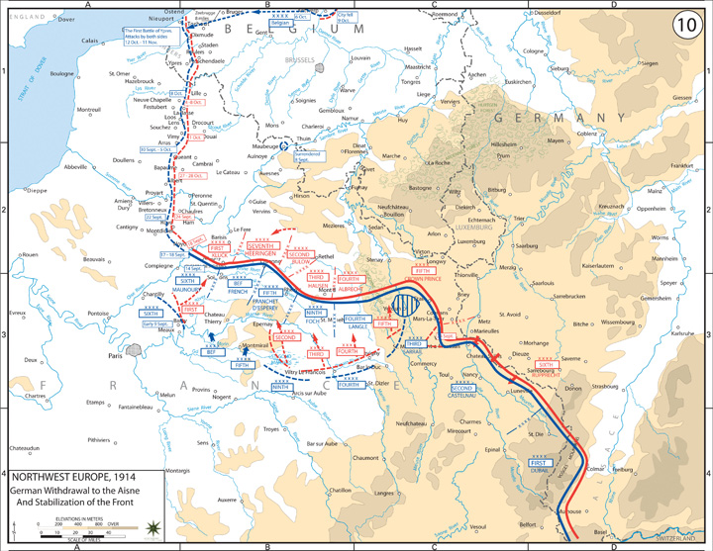
Trenches
Trench life can be
miserable
Stretch from English Channel to Switzerland
Notes:
PG 461 (MAP) & 462 (infographic) & 466(All Quiet on Western Front)

Slide 8
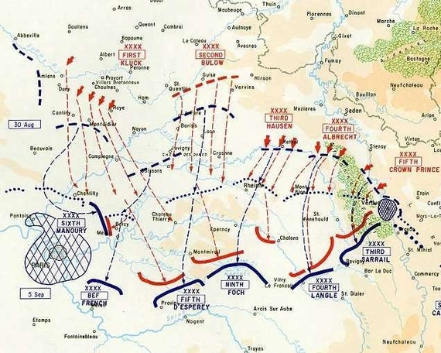
Significant Battles: First Battle of Marne
September 5-11, 1914
Germany swept through Belgium and N. France and are stopped short distance from Paris
French Gen. Josef Joffre launched counter offensive
Germans fell back; France/Paris saved by taxi cabs
Western front turns into a stalemate

Slide 9
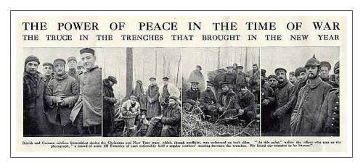
Christmas Truce – December 1914
Individual Units call truces on local level
Army does not want that
Force them back to war
Only winter it happened

Slide 10
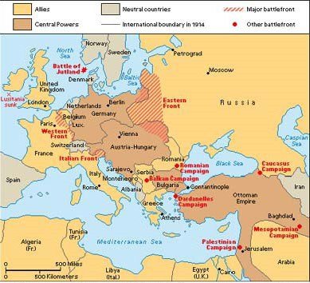
1915: Allies Attempt an Additional Front
Additional Fronts make concentration difficult
Germany Already fighting 2 fronts
Third would stretch Germany thin
Winston Churchill Convinces Britain to open Balkan Front

Slide 11
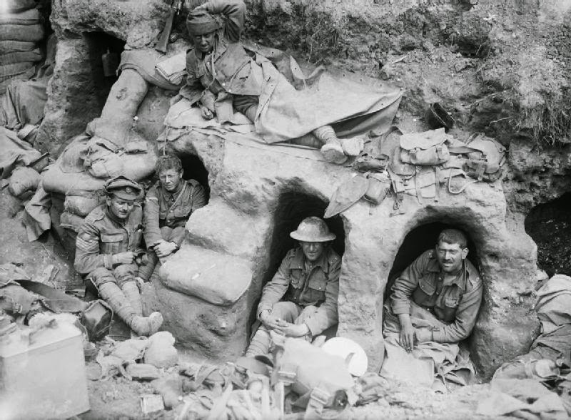
Gallipoli 1915
Attempt to open Balkan front by attacking Gallipoli near Constantinople
March 1915 – naval bombardment
April 1915 – land forces arrive
Turks evacuate forts during bombardment
Forts of Gallipoli are refortified; Allies are forced to evacuate
Anzac Soldiers “Dug in”
Gallipoli, 1915

Slide 12
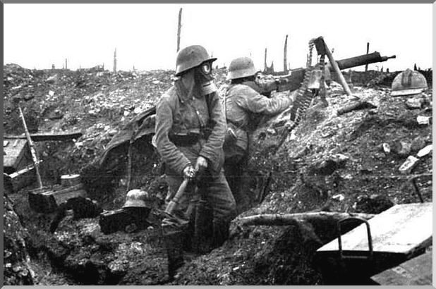
“Break the Stalemate”: Verdun, 1916
Began as a German offensive
Trench warfare at it’s best: heavy bombardment then send in troops
Attacking troops faced heavy machine gun fire
War of Attrition – wear the other side down – Germany believed France would quit if Verdun fell
Duration: 21 Feb – 18 Dec, 1916
France Held on
Casualties: 377,000 French
337,000 German

Slide 13
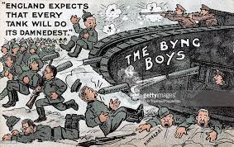
Summer 1916: The Somme
Joint French/British offensive
War of attrition – wear down Germans
Relieve French at Verdun
Territorial gains 2nd aim
8 day military bombardment of German troops is ineffective at destroying barbed wire and concrete bunkers
750,000 men advance on German troops on July 1st
British suffer 58,000 casualties in first day
September – first tanks are used
By November, heavy snow ends the offensive
Somme helps end Battle of Verdun
Notes:
SOMME Worksheet

Slide 14
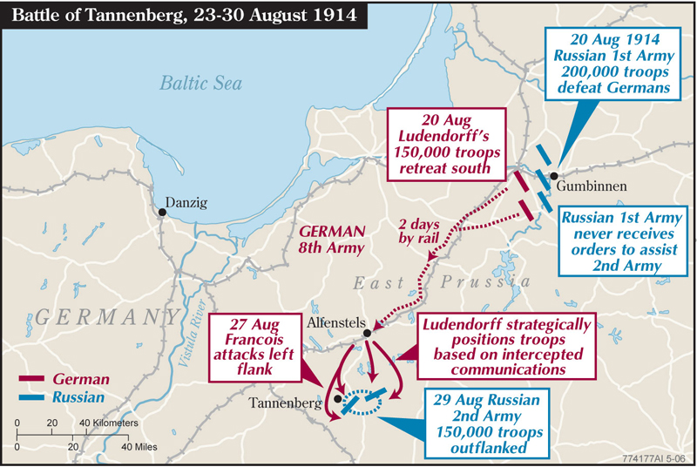
Eastern Front: Tannenberg, 1914
Russia Invades Germany with 2 armies – initially successful
Communication issues kept 1st Army out of battle
Germany consolidated forces and encircled Russian 2nd Army
Russia started with 190,000 troops
95,000 Russian Troops Captured
30,000 Russian Troops killed or wounded
Indicative of things to come for Russia

Slide 15
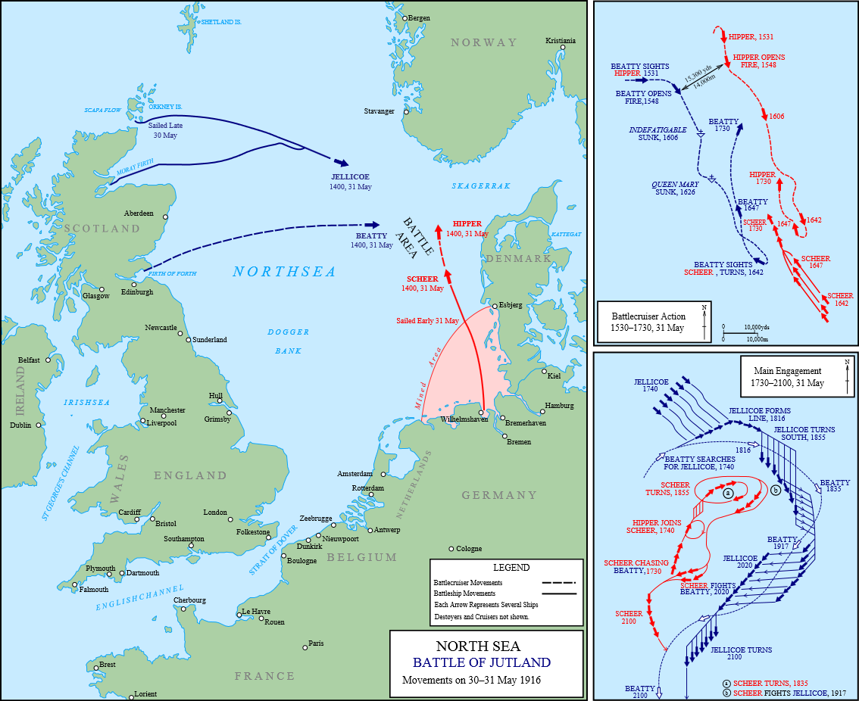
Naval Warfare: Battle of Jutland
German attempt to dislodge British Superiority
North Sea, 31 May – 01 June 1916
British: 151 combat ships (28 battleships)
German: 99 Combat ships (16 battleships)
LOSSES:
British- 14 ships (113k ton) over 6,000 sailors
German- 11 ships (62k ton) over 2500 sailors
German tactical victory/strategic loss

Slide 16
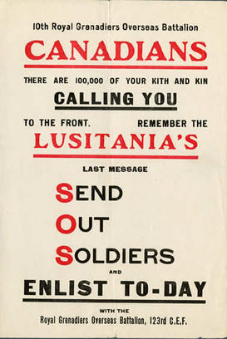
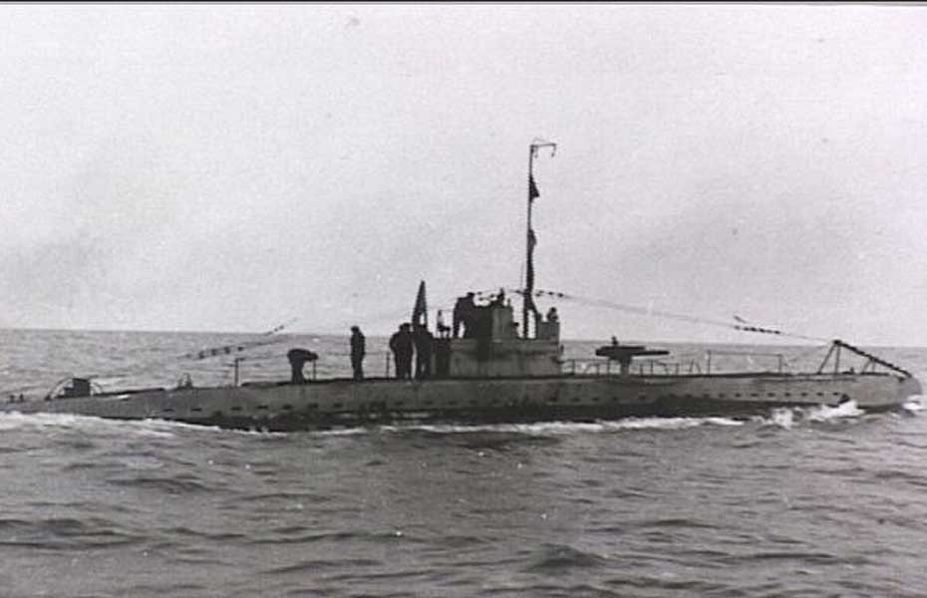
Germany wanted to gain
“Command of the Sea”
Britain quickly replaced lost combat ships
Germany never directly confronted again
British Blockade starved Germany
German U-Boats = unrestricted warfare in waters around England
Total u-boat damage from war = >12,000,000 tons
Sinking of Lusitania part of US Entry in war (1915)

Slide 17
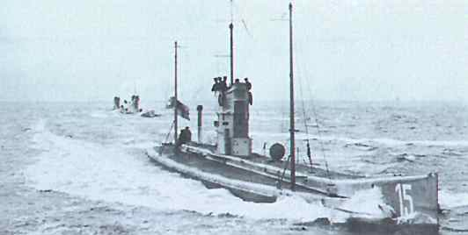
U-Boat
Used as commerce raiders on civilian shipping
Cheap way for Germany to use its Navy
Diesel engines charged batteries and supplied propulsion when on the surface
375 Were commissioned; Sank close to 5,000 ships

Slide 18
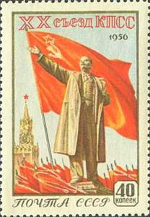
Russian Revolution
By 1918 Russia’s military failures, coupled with political and social issues leads to the Communist Revolution
Treaty of Brest-Litovsk ends war between Russia and Central Powers, 03 March 1918
Germany now has a 1 front war
Notes:
Letters of Lenin
Pg 481 (Infographic)

Slide 19
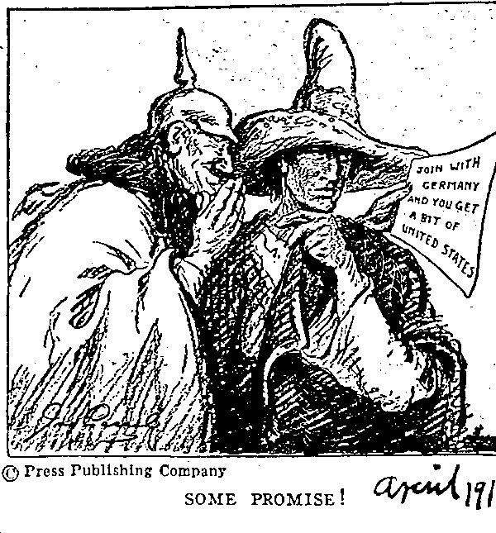
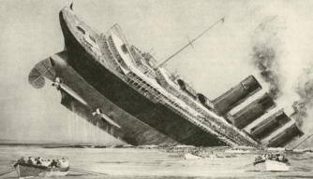
US Entry in the War
US Exports to both sides:
US Attempts Neutrality
US Business does not
Unrestricted Submarine Warfare increases tensions
Lusitania
Zimmerman Telegram
Encourages Mexico to declare war on US

Slide 20
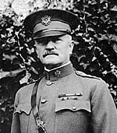
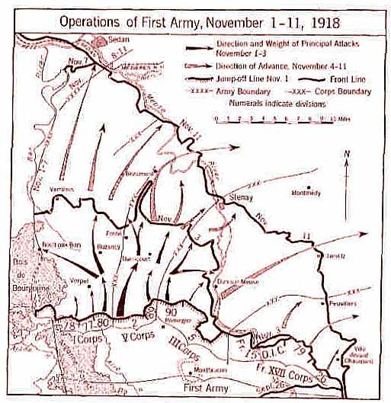
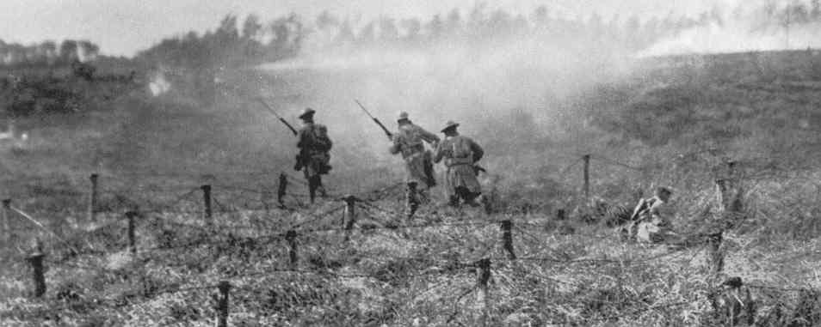
US Declares War April 6 1917
Wilson and Pershing Insist on fighting as cohesive army rather than replacement troops for Allies
May 28, 1918: Cantigny is first “V”
12-15 Sep: St.-Mihiel First Solo US offensive
September 26 to 11/11: Meuse-Argonne Offensive ends war

Slide 21
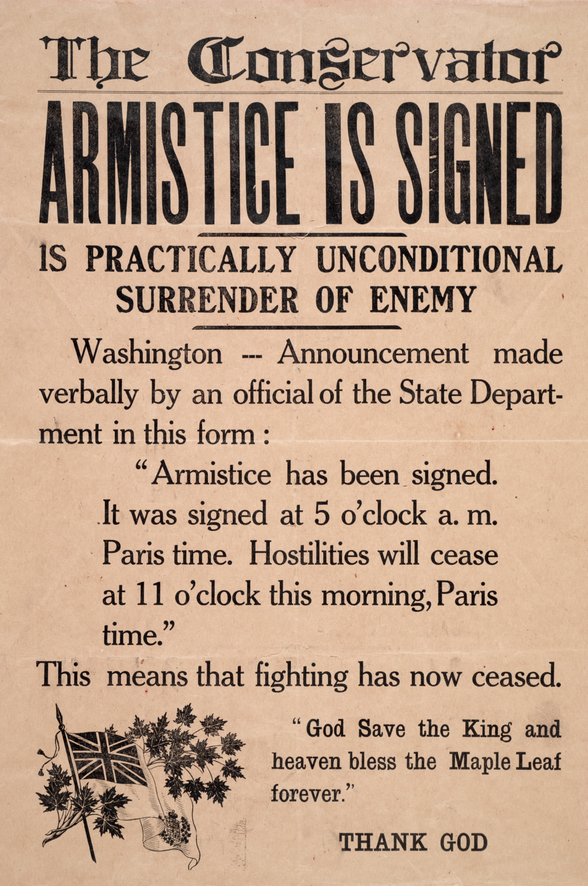
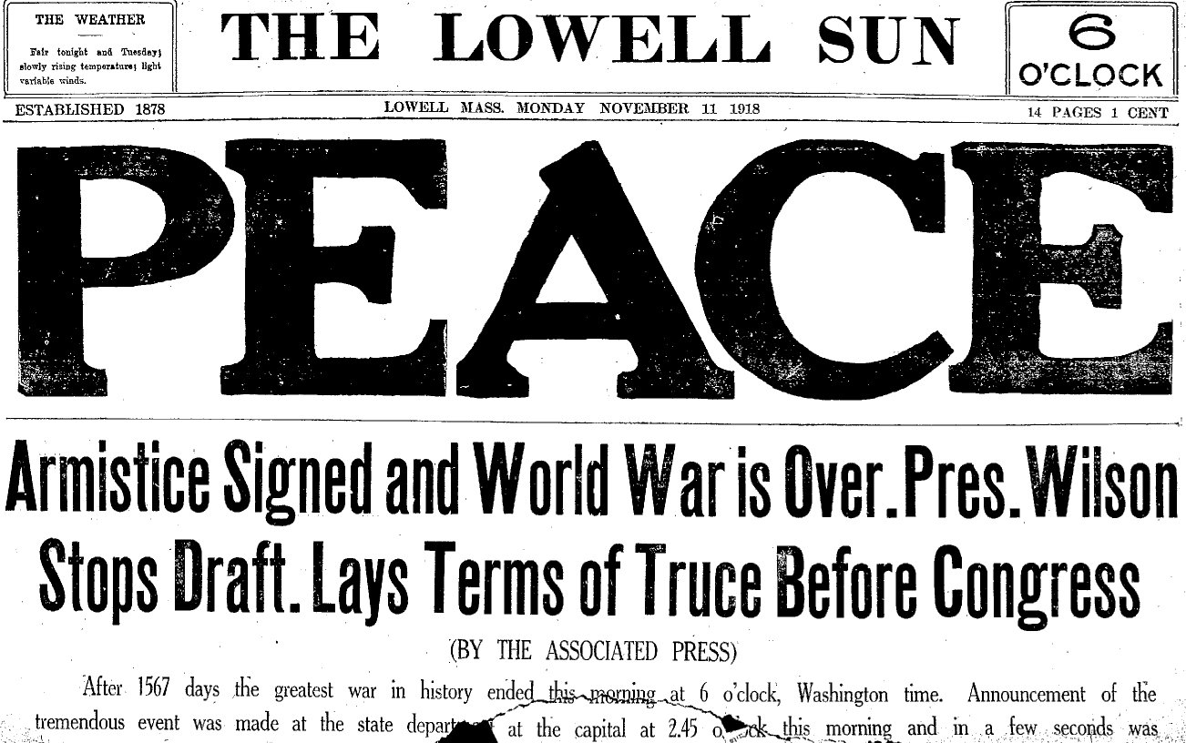
Armistice Day November 11, 1918
Ends the hostilities
Forces Germany to peace negotiations

Slide 22
Notes:
Poetry Worksheet

Slide 23
Notes:
War Diary

