Slide 1
Merlin Bird ID App
How to Sign Up

Slide 2
Merlin Bird ID
The app is free and available from the Apple App store or Google Play.
It will take about 300 MB of storage.

Slide 3
After you click on the “Install”, click on the “Accept” button.
You will need to provide an email account that a verification email will be sent to. If you do not confirm the verification email, the app will stop working after a few days.

Slide 4
Once it is installed, click “Open”.

Slide 5
This is the home screen for the Merlin App. Click on “Start Bird ID”.

Slide 6
This screen will appear next. Click on “Browse Packs”.

Slide 7
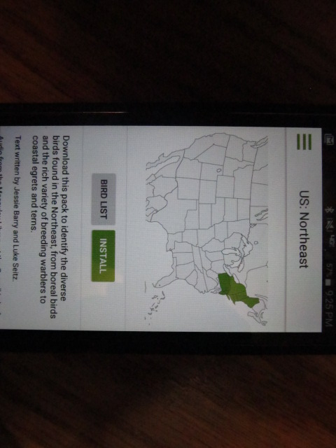
Select the “US: Northeast” pack to include the birds of PA.
Install the pack.

Slide 8
To search for a bird by name, select the menu bar in the upper left corner of the screen.

Slide 9
Select “Browse All Birds” from the menu.

Slide 10
Type in the name of the bird.

Slide 11
Select it from choices that come up.

Slide 12
A picture and a description of the bird will come up.
Click on the sounds tab.

Slide 13
Select the song you wish to hear and press the play button.

Slide 14
You can ID an unknown bird based on color and size using the “Start Bird ID” button.
You can take a picture of a bird and use the “Get Photo ID” button to upload the picture so Merlin can try to identify the bird for you.

