Slide 1
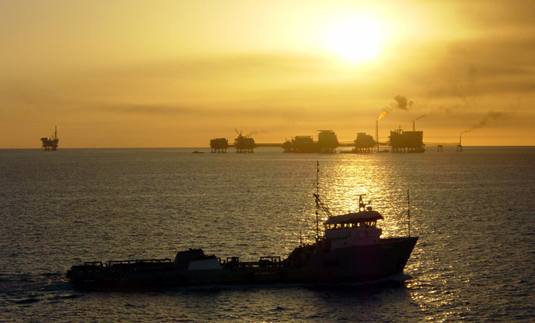
The Gulf of Mexico’s Dead Zone
Fishing for Answers in
Kristi Hannam, SUNY-Geneseo
Notes:
http://commons.wikimedia.org/wiki/File:Gulf_of_Mexico_with_ship.jpg

Slide 2
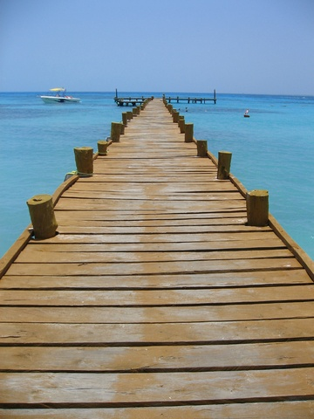
Summer at the Seafood Shack
Susan had moved in with Aunt Janet in Louisiana for the summer. She wanted to enjoy the sun and the beach, and save some money for college next fall. A week ago, she found a job as a waitress at Captain Joe’s Seafood Shack.
At lunch, a businessman asked: “Where’s the shrimp from anyway?”
She’d been asked this twice before already, so she knew the answer. “From Thailand.”
Notes:
http://www.dreamstime.com/royalty-free-stock-images-tropical-pier-image2731349
© Jessica Fitzel | Dreamstime.com

Slide 3
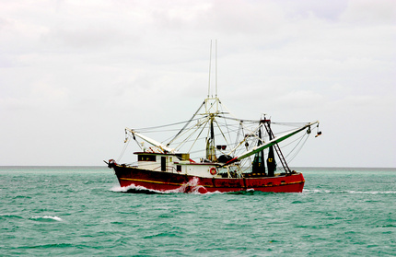
Next Morning
The next morning, Susan and Aunt Janet were eating breakfast while watching boats on the Gulf.
Aunt Janet pointed. “See that boat with the funny stuff sticking out the back? That’s George. He’s a shrimper.”
“A shrimper? Then why does Captain Joe buy shrimp from Thailand?”
“I don’t know. Why don’t you ask him?”
Notes:
© Rimasz - Fotolia.com
http://www.fotolia.com/id/2550948

Slide 4
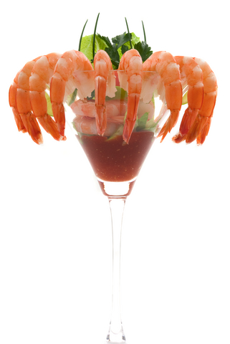
Business Decision
Captain Joe was busily setting up lunchtime plates when Susan found him.
“If there are shrimp in the Gulf, why do you buy shrimp from Thailand, Captain Joe?”
He stared at her, annoyed by the interruption. “Too expensive!” he grunted.
Notes:
http://www.dreamstime.com/stock-photo-shrimp-cocktail-image5658400
© Bvdc | Dreamstime.com

Slide 5
Front Porch Chat
At Aunt Janet’s that evening, Susan found her aunt sitting on the front porch talking to George. After introducing herself, Susan asked him, “Is Captain Joe’s the only restaurant around here that doesn’t serve local shrimp?”
Notes:
http://commons.wikimedia.org/wiki/File:2009_shawnee_state_park_lodge_back_porch_rockers.jpg

Slide 6
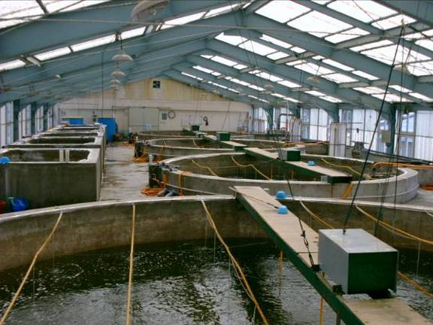
Shrimp Farms
“Definitely not,” George said in reply to Susan’s question.
“Most of the area right off the coast here isn’t good for fishing or shrimping anymore. Restaurant owners can get cheaper shrimp from farms in Asia or South America,” he added.
Notes:
http://commons.wikimedia.org/wiki/File:Shrimp_hatchery.jpg

Slide 7
#1: What do YOU think might be the reason why shrimp have disappeared from local waters?
Overfishing has depleted shrimp populations.
Pollution has killed off shrimp populations.
Rising water temperatures caused by climate change have made the habitat inhospitable to shrimp.
Hurricane Katrina destroyed all the shrimp and their habitat.

Slide 8
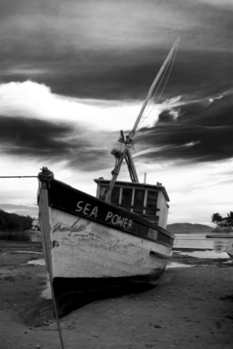
George continued: “People around here have a lot of different ideas about why shrimp are going away. Some think hurricanes like Katrina are to blame, others think overfishing, pollution, or climate change are the cause. I don’t know for sure, but something has definitely happened – people are calling our part of the Gulf a Dead Zone – and it seems to be growing every year.”
Dead Zone
8
Notes:
http://www.dreamstime.com/royalty-free-stock-photography-old-fishing-boat-image4142907

Slide 9
The four working hypotheses for the Dead Zone are:
Hurricane Katrina (2005)
Pollution
Climate change
Overfishing

Slide 10
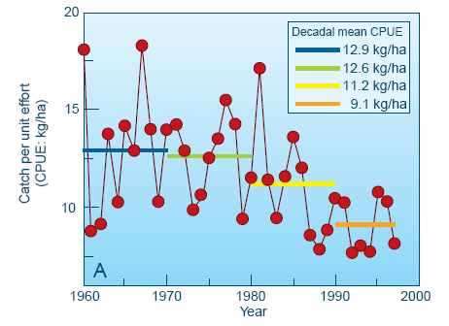
#2: What does this graph tell you has happened to the average shrimp catch from 1960 - 2000?
The graph shows annual changes of CPUE for brown shrimp in areas of the Gulf of Mexico. The colored bars are “decadal means.” They show the average CPUE for a span of ten years (CPUE = catch per unit effort). Data: James Nance, National Marine Fisheries Service.

Slide 11
#3: Which hypothesis does this graph NOT support and therefore eliminate? Why can you rule that hypothesis out?
A. Hurricane Katrina
B. Pollution
C. Climate Change
D. Overfishing

Slide 12
Watching the local news that night, Susan saw the image below of the Gulf Coast at the mouth of the Mississippi River that caught her attention:
Source: NASA Earth Observatory

Slide 13
What caught her attention?

Slide 14
#4: Which hypothesis does the evidence in this image support?
A. Hurricane Katrina
B. Pollution
C. Climate Change
D. Overfishing

Slide 15
Susan decided to investigate the sediment plume to see if there was a link to the disappearing shrimp in the Dead Zone.
Her research
revealed the
following map:
Watersheds of the Mississippi River Basin
Source: USGS Fact Sheet 016-00

Slide 16
Susan realized that runoff from an enormous area could be causing the sediment plume.
BUT:
The SIZE of the Mississippi River watershed probably hasn’t changed in thousands of years.
People have been shrimping and fishing in the Gulf for over 100 years.
So WHAT could be causing the problem now?
Source: USGS Fact Sheet 016-00

Slide 17
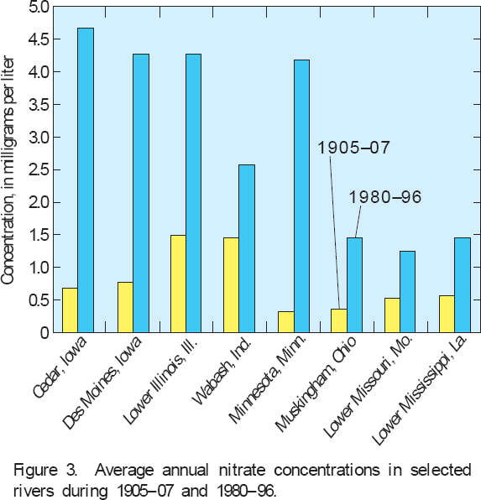
#5: What does this figure tell you has increased in the runoff to the Mississippi River basin over time?
Source: USGS Fact Sheet 135–00

Slide 18
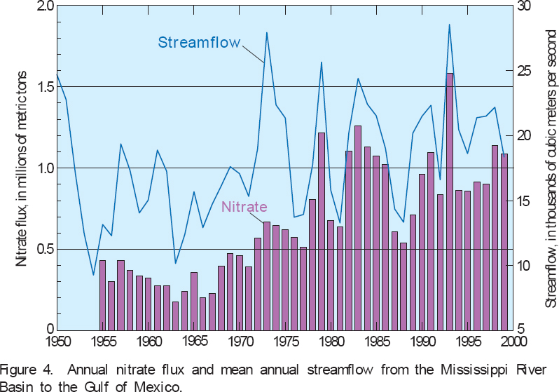
Streamflow and Nitrate levels in the Mississippi River basin over time
Source: USGS Fact Sheet 135–00

Slide 19
#6: What do these figures together tell you about the runoff to the Mississippi River basin over time?
Annual nitrate concentrations have increased over time.
Stream flow has remained fairly constant over time.
The biggest source of nitrates is the area farthest from the Gulf of Mexico.
Only A and C.
A, B, and C are true.

Slide 20
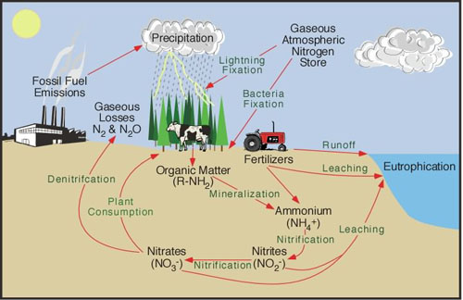
Susan recalled a figure from her biology course
http://serc.carleton.edu/images/microbelife/microbservatories/northinlet/Nitrogen_Cycle

Slide 21
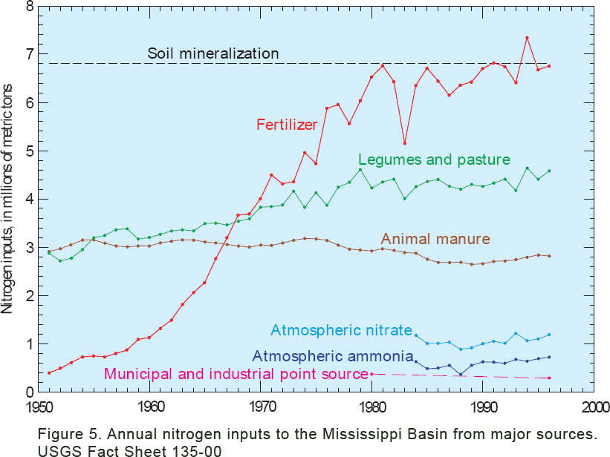

Slide 22
#7: Using the graph from the previous slide , what is the most likely source of the increasing levels of nitrogen in the runoff?
Fossil fuel emissions.
Organic matter.
Leaching of nitrates from nitrification.
Fertilizer runoff.

Slide 23
Susan realized that her Internet research had distracted her from her original question about shrimp. How could increased nitrates be connected to decreased fish and shrimp populations? She had figured out this much: Nitrates flow into the Gulf of Mexico from the Mississippi River watershed (especially states further north). The nitrates are carried by the freshwater river into the saltwater Gulf of Mexico.
Susan’s Question

Slide 24
Interior Watersheds of the Mississippi
River Basin
Largest river basin in North America.
Third largest basin in the world.
Includes 70 million people, 30 states.
One of the most productive farming regions in the world:
~60% of the basin is cropland
( corn, soybeans, wheat)
~20% woodland,
~20% barren land,
~2% wetland, and
~ 0.6% urban land
(Goolsby and Battaglin, 2000 )
Source: USGS Fact Sheet 016-00

Slide 25
#8: When the freshwater river flows into the saltwater Gulf, what do you predict will happen?
The freshwater and the saltwater will mix, lowering the overall salinity of the Gulf.
The warmer freshwater will sink to the bottom of the Gulf, and the colder saltwater will float above.
The less dense freshwater will float on top of the more dense saltwater.
The amount of freshwater entering the Gulf is so small compared to the total volume of the Gulf that there will be no noticeable effect of the freshwater input.

Slide 26
Temperature & Salinity Layering
Video of temp & salinity experiments
http://www.smm.org/deadzone/activities/top.html
Go to the link above. Watch the experiment shown under “Create a Model of Temperature Layering” and answer the following questions.
#9. What is the phenomenon called when the two layers of different temperatures of water do not mix?
#10. This phenomenon makes it harder for what to enter the water – especially in the summer when the winds are low?
#11. Does this phenomenon contribute to the Gulf of Mexico dead zone?

Slide 27
Video of temp & salinity experiments
http://www.smm.org/deadzone/activities/top.html
Using the same link, watch the experiment shown under “Create a Model of Density Layering” and answer the question below.
#12 – Based on what you viewed in the experiment, what happens when the freshwater from the Mississippi river enters the salty water of the Gulf of Mexico?

Slide 28
Video of what happens in the Gulf
http://www.smm.org/deadzone/causes/dead-zone.html
Using the link above, go through the stages of the animation and answer the questions below.
#13 – Give two reasons why the dissolved oxygen in the deeper waters of the Gulf is lowered when the freshwater of the Mississippi enters the Gulf.
#14 – When the D.O. levels are lowered, what happens to the fish and other organisms that live there?

Slide 29
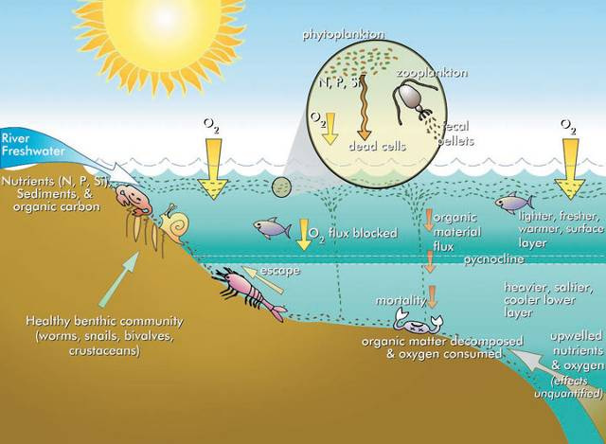
What Happens Next?
Excess nitrogen and more sunlight in surface waters leads to algae blooms.
The algae bloom provides food for zooplankton such as copepods.
Copepod wastes and dead algae sink to the bottom of the Gulf and decomposition lowers oxygen levels.
Continuing decomposition by bacteria lowers oxygen levels even more.
Source: http://www.epa.gov/msbasin/taskforce/hypoxia.htm

Slide 30
Eutrophication leads to hypoxia in the benthic waters (water near the bottom) of the Gulf
Normal oxygen levels: ~ 4.8 mg/L
Hypoxia: < 2-3 mg/L
Anoxia: 0 mg/L (no oxygen in the water)
Shrimp live on and near the ocean bottom.

Slide 31
Stratification and Hypoxia
Source: http://www.eco-check.org/forecast/chesapeake/methods/

Slide 32
Is there evidence of hypoxia in the Gulf of Mexico?
Bottom-Water Dissolved Oxygen
18-23 July 2009 Data
Data source: N.N. Rabalais, Louisiana Universities Marine Consortium, R.E. Turner, Louisiana State University Funded by: NOAA, Center for Sponsored Coastal Ocean Research

Slide 33
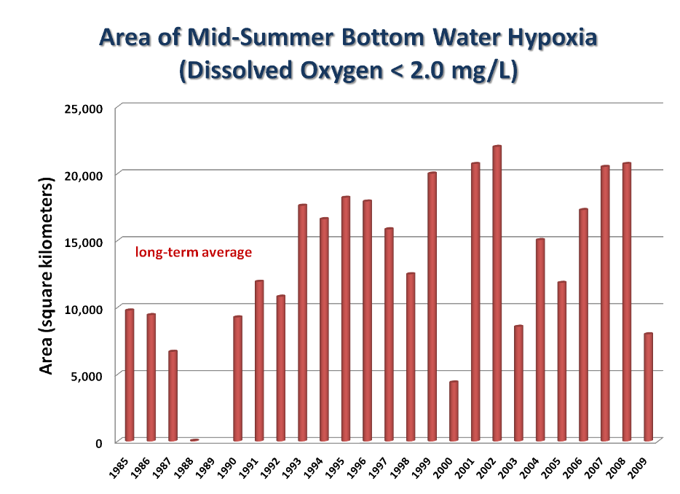
5-yr
average
goal
n.d.
Data source: N.N. Rabalais, Louisiana Universities Marine Consortium, R.E. Turner, Louisiana State University
Funded by: NOAA, Center for Sponsored Coastal Ocean Research
Notes:
Is there evidence of hypoxia in the Gulf of Mexico? Estimated bottom-water extent of hypoxia (dissolved oxygen < 2 mg l⁻¹) for mid-summer cruises, superimposed with long-term average, five-year average and 2015 goal of 5,000 km².

Slide 34
George said “People are calling our part of the Gulf a Dead Zone – and it seems to be growing every year.” #15 – What do you think he means by the term “Dead Zone”? #16 – What is causing the Dead Zone? (The links on slides 26- 28 provide an answer to the two questions above.) #17 – Does the evidence support his claim that the Dead Zone is growing in size each year? Why or why not?
What is the Dead Zone?
34
Notes:
http://www.dreamstime.com/royalty-free-stock-photography-old-fishing-boat-image4142907

Slide 35
#18: Does the evidence you’ve seen so far mean that climate change and overfishing are NOT to blame for the decline of the shrimp fishery?
Yes
No

Slide 36
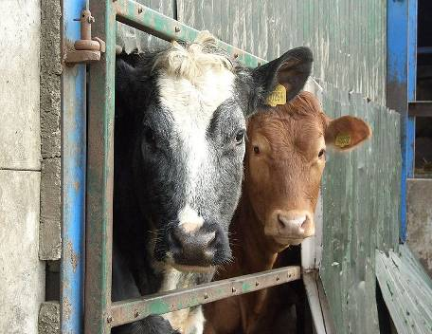
Responsibility
Upon figuring this all out, Susan was quite upset. She was amazed that farmers in the Midwest might be to blame for the lack of shrimp in the water off the Louisiana coast.
#19: Describe how the farmers in the Midwest could be responsible for the lack of shrimp in Louisiana. Be sure to include what they are doing on the land, the role of the nitrogen cycle, and how it is specifically impacting shrimp habitat in the Gulf of Mexico.

Slide 37
Suppose you are on a government panel studying the Dead Zone problem. #20: What recommendations would you make for solving the problem of the Dead Zone? Include who should be responsible for fixing the problem and what actions they should take.

Slide 38
The Other Hypotheses #21: The temperature of the Earth’s atmosphere has increased in the last century. This would increase the temperature of the ocean surface water. How could this climate change contribute to the Dead Zone problem? #22: How could overfishing contribute to the Dead Zone problem?

Slide 39
Unit Summary #23: How does this case study demonstrate the interactions between abiotic and biotic factors in the Gulf of Mexico ecosystem? Give several specific examples. #24: How does this case study demonstrate the interactions that take place between ecosystems – such as land and aquatic ecosystems?

Slide 40
Unit Summary #25: This case study is a good example of artificial eutrophication of an aquatic system caused by human activities. Look at the next slide. Each red dot indicates an area where artificial eutrophication takes place. What types of countries (developed/developing) seem to have the greatest problem with eutrophication? Why do you think that is?

Slide 41
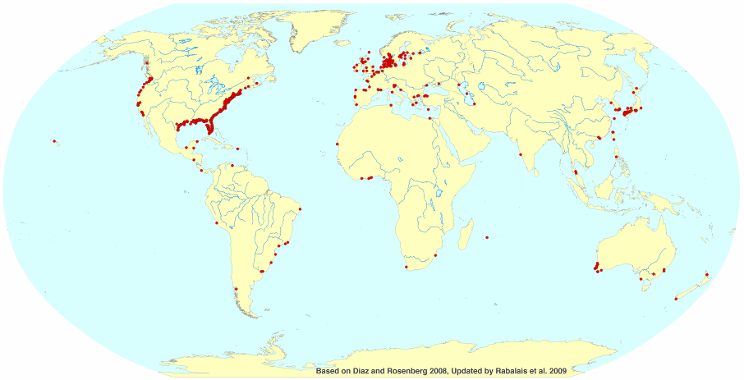
Sites of Eutrophication Worldwide

Slide 42
Slide Credits
Slide 1
Description: Photo of Gulf of Mexico with ship.
Author: Chad Teer
Source: Flickr, http://www.flickr.com/photos/22437367@N00/944510
Licensing: http://www.flickr.com/photos/cteer/ / CC BY-NC 2.0
Slide 2
Description: Photo of pier.
Author: Jessica Fitzel
Source: Dreamstime.com, http://www.dreamstime.com/royalty-free-stock-images-tropical-pier-image2731349
Licensing: Licensed, royalty free image.
Slide 3
Description: Photo of shrimp boat.
Author: Rimasz
Source: Fotolia.com, http://www.fotolia.com/id/2550948
Licensing: Licensed, royalty free image.
Slide 4
Description: Photo of shrimp cocktail.
Author: Brian & Vildan Chase
Source: Dreamstime.com, http://www.dreamstime.com/stock-photo-shrimp-cocktail-image5658400
Licensing: Licensed, royalty free image.
Slide 5
Description: Photo of beach porch at sunset.
Author: Ron Chapple Studios
Source: Dreamstime.com, http://www.dreamstime.com/royalty-free-stock-images-beachfront-porch-image2051669
Licensing: Licensed, royalty free image.

Slide 43
Slide 6
Description: A hatchery on a shrimp farm in South Korea.
Source: Wikimedia Commons, http://commons.wikimedia.org/wiki/File:Shrimp_hatchery.jpg
Licensing: This image is in the public domain because it contains materials that originally came from the U.S. National Oceanic and Atmospheric Administration, taken or made during the course of an employee’s official duties.
Slide 8
Description: Photo of old fishing boat.
Author: Gabriel Nardelli Araujo
Source: Dreamstime.com, http://www.dreamstime.com/royalty-free-stock-photography-old-fishing-boat-image4142907
Licensing: Licensed, royalty free image.
Slide 10 and Slide 11
Description: Brown Shrimp catch graph.
Source: Left panel of Figure 3.6 in: Council for Agricultural Science and Technology (CAST). 1999. Gulf of Mexico Hypoxia: Land and Sea Interactions. Task Force Report 134. CAST, Ames, Iowa.
Link: http://www.public.iastate.edu/~downing/tier%202/jadpdfs/1999%20Gulf%20of%20Mexico.pdf
Licensing: Used with permission.
Slide 13 , Slide 14 , and Slide 15
Description: Mississippi River sediment plume in Gulf of Mexico.
Author: Liam Gumley, Space Science and Engineering Center, University of Wisconsin—Madison and the MODIS science team.
Source: NASA Earth Observatory website, http://earthobservatory.nasa.gov/IOTD/view.php?id=1257
Licensing: Used with permission.
Slide 17 , Slide 18 , and Slide 26
Description: Interior watersheds of the Mississippi River Basin.
Source: USGS Fact Sheet 016-00—Restoring Life to the Dead Zone: Addressing Gulf Hypoxia, a National Problem
Link: http://www.nwrc.usgs.gov/factshts/016-00/016-00.htm
Licensing: Public domain, a work of the US Federal Government under the terms of Title 17, Chapter 1, Section 105 of the US Code.
Slide19 and Slide 21 —Left
Description: Average annual nitrate concentrations in selected rivers during 1905–07 and 1980–96.
Source: Figure 3 in “Nitrogen in the Mississippi Basin-Estimating Sources and Predicting Flux to the Gulf of Mexico” by Donald A. Goolsby and William A. Battaglin. USGS Fact Sheet 135-00, December 2000.
Link: http://ks.water.usgs.gov/pubs/fact-sheets/fs.135-00.pdf
Licensing: Public domain, a work of the US Federal Government under the terms of Title 17, Chapter 1, Section 105 of the US Code.

Slide 44
Slide 20 and Slide 21 —Right
Description: Annual nitrate flux and mean annual streamflow from the Mississippi River Basin to the Gulf of Mexico.
Source: Figure 4 in “Nitrogen in the Mississippi Basin-Estimating Sources and Predicting Flux to the Gulf of Mexico” by Donald A. Goolsby and William A. Battaglin. USGS Fact Sheet 135-00, December 2000.
Link: http://ks.water.usgs.gov/pubs/fact-sheets/fs.135-00.pdf
Licensing: Public domain, a work of the United States Federal Government under the terms of Title 17, Chapter 1, Section 105 of the US Code.
Slide 22 and Slide 24
Description: Illustration of the nitrogen cycle.
Author: Michael Pidwirny
Source: Pidwirny, M. (2006). Figure 9s-1, “The Nitrogen Cycle,” Fundamentals of Physical Geography, 2nd Edition.
Link: http://www.physicalgeography.net/fundamentals/9s.html
Licensing: Used with permission.
Slide 23
Description: Annual nitrogen inputs to the Mississippi Basin from major sources.
Source: Figure 5 in “Nitrogen in the Mississippi Basin-Estimating Sources and Predicting Flux to the Gulf of Mexico” by Donald A. Goolsby and William A. Battaglin. USGS Fact Sheet 135-00, December 2000.
Link: http://ks.water.usgs.gov/pubs/fact-sheets/fs.135-00.pdf
Licensing: Public domain, a work of the United States Federal Government under the terms of Title 17, Chapter 1, Section 105 of the US Code.
Slide 29
Description: How marine hypoxia & eutrophication happens.
Source: Hypoxia 101, What is hypoxia and what causes it? EPA, OW, Office of Wetlands, Oceans, and Watersheds.
Link: http://www.epa.gov/msbasin/hypoxia101.htm
Licensing: Public domain, a work of the United States Federal Government under the terms of Title 17, Chapter 1, Section 105 of the US Code.
Slide 31
Description: Environmental factors that affect dissolved oxygen.
Source: EcoCheck, a partnership program between NOAA Chesapeake Bay Program Office and the Integration and Application Network (IAN) at the University of Maryland Center for Environmental Sciences (UMCES).
Link: http://www.eco-check.org/forecast/chesapeake/2009/methods/#_DO_-_anoxia
Licensing: Used with permission.

Slide 45
Slide 32
Description: Map of hypoxic zone in Gulf of Mexico.
Source: Gulf of Mexico Dead Zone Surprisingly Small in Area, but Severe. July 24, 2009. N.N. Rabalais, Louisiana Universities Marine Consortium, R.E. Turner, Louisiana State University Funded by: NOAA, Center for Sponsored Coastal Ocean Research.
Link: http://www.gulfhypoxia.net/Research/Shelfwide%20Cruises/2009/Files/Press_Release.pdf
Licensing: Used with permission.
Slide 33
Description: Graph of extent of hypoxia in Gulf of Mexico.
Source: Gulf of Mexico Dead Zone Surprisingly Small in Area, but Severe. July 24, 2009. N.N. Rabalais, Louisiana Universities Marine Consortium, R.E. Turner, Louisiana State University Funded by: NOAA, Center for Sponsored Coastal Ocean Research.
Link: http://www.gulfhypoxia.net/Research/Shelfwide%20Cruises/2009/Files/Press_Release.pdf
Licensing: Used with permission.
Slide 35
Description: Photo of cows.
Author: Andy Wright from Sheffield, UK
Source: Wikimedia Commons, although originally posted to Flickr.
Link: http://commons.wikimedia.org/wiki/File:Cows.jpg
Licensing: Creative Commons Attribution 2.0 License.
Slide 39
Description: Global map showing sites of marine hypoxia.
Source: Louisiana Universities Marine Consortium
Link: http://www.gulfhypoxia.net/Overview/
Licensing: Used with permission.

