Slide 1
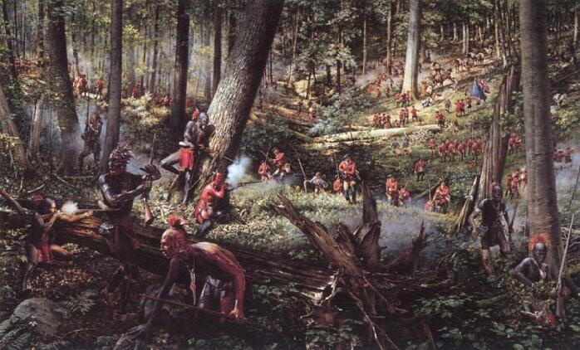
You’re in command
The Battle of the Monongahela
July, 9th 1755

Slide 2
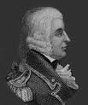
Intro & Objective
You and your partner are General Edward Braddock & Major George Washington.
Your group’s mission is to defeat the French forces blocking your path to Fort Duquesne while keeping causalities to a minimum.
Maj. George Washington
Gen. Edward Braddock

Slide 3
The Opposing Armies
British
French
1,500 total soldiers
Mix of regulars & colonial militia.
Regulars- highly disciplined & fight in the European style.
Colonial militia- not highly disciplined, but can fight in both European & NA style.
1,300 total soldiers
Mix of regulars, colonial militia & Native American allies.
Regulars- highly disciplined & fight in the European style.
Colonial militia- not highly disciplined, but can fight in both European & NA style.
Native Americans- fight strictly in guerilla style.

Slide 4
The Situation
Your scouts and the French scouts engage in minor skirmishing, which is a surprise to both sides.
Your advanced guard of the elite Grenadiers encounters a body of French regulars blocking the road on a hilltop, while the French militia and Natives occupy the high ground on your flanks.
General Braddock & Major Washington, what are your orders?
Explain, in three paragraphs, how your group will use the two differing style tactics to defeat the enemy.

Slide 5
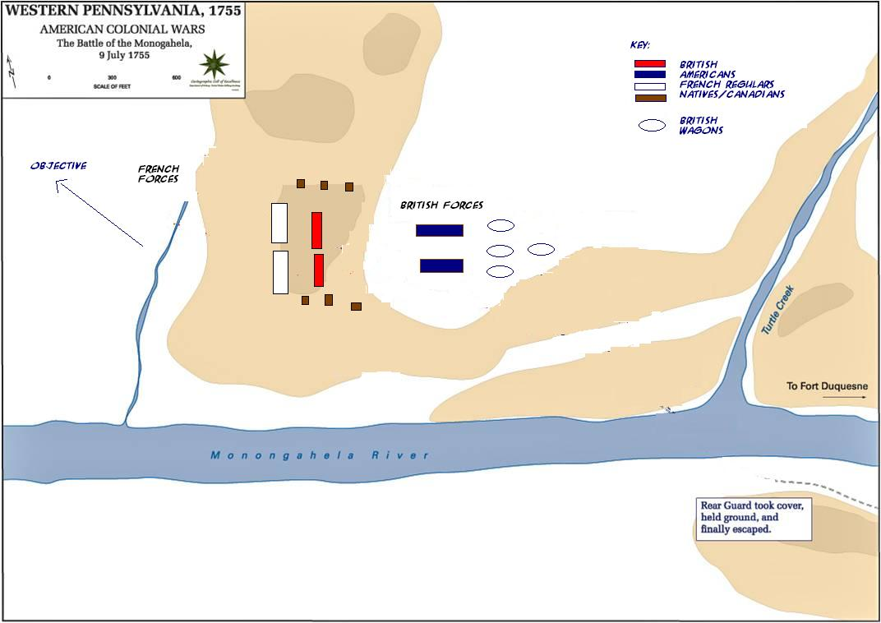
Battle Map

