Slide 1
Causes of world War I

Slide 2
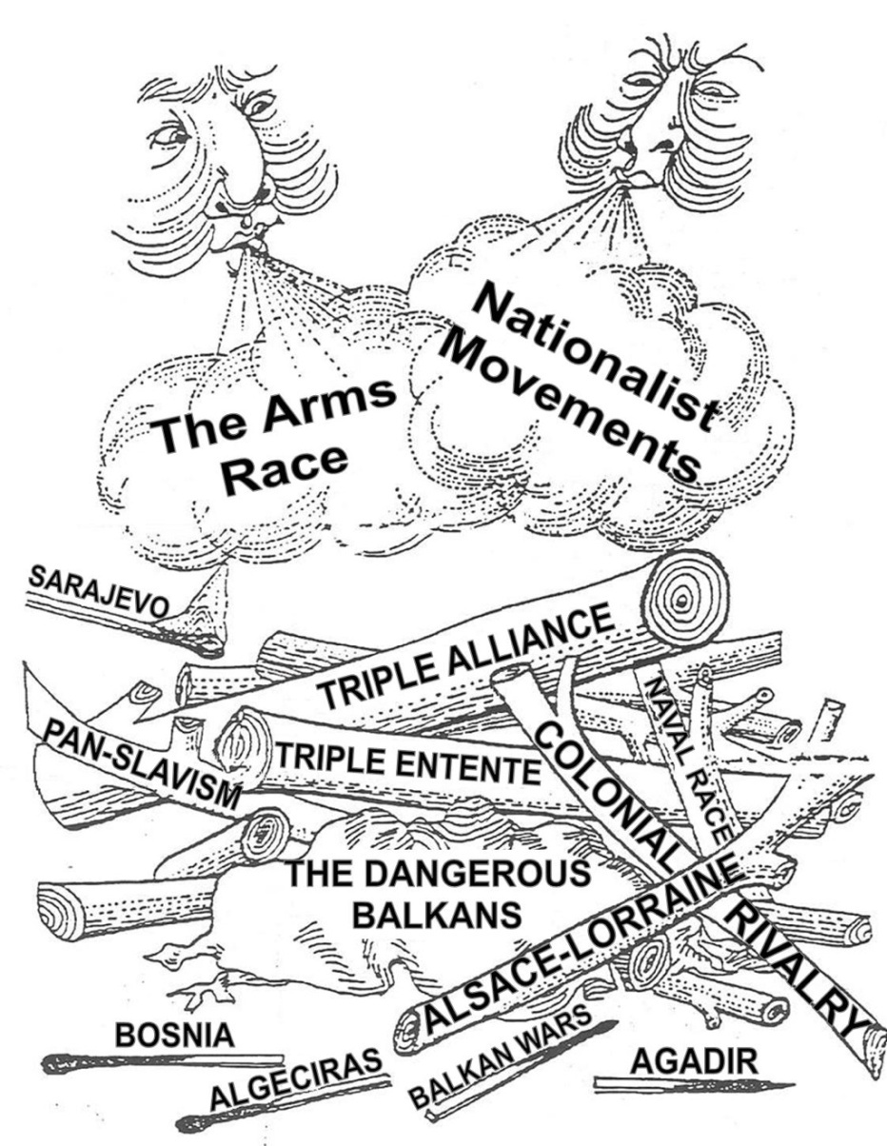
M-A-I-N Causes
An acronym for the 5 main causes of WW1
M: Militarism
A: Alliances
I: Imperialism
N: Nationalism

Slide 3
Imperialism
WHY?
The Industrial Revolution created needs and desires that spurred overseas expansion
Industrial powers needed ports around the world for ships to get supplies
There was a belief that colonies were needed for national security (Nationalism – more on that later)
Missionaries believed it their duty to spread Western civilization. They saw Western civilization as more superior than other societies.

Slide 4
Imperialism
All of the great powers were competing for colonies/territory
After 1870, the European nations began to acquire colonies in Africa, Asia, and the Pacific
Colonial rivalries lead to:
strained relationships among European powers due to the many clashes between France, Britain, Germany and Italy in Africa

Slide 5
Imperialism: Africa
By the early 1800s Muslim influence in North Africa from the Ottoman empire was declining, in East Africa the slave trade continued, in South Africa Zulu (native African peoples) came into conflict with migrating Boers (Dutch plantation owners).
Medical advancements (to combat disease), and river steam ships (to gain access to the interior of Africa) caused more contact among Africans and Europeans after 1800.
One of the most well known explorers of the African interior is Dr. David Livingstone
In 1869, after nearly 30 years of crisscrossing the continent he was discovered by journalist Henry Stanley in Central Africa (present-day Tanzania)
Livingstone wrote about the people he met with more sympathy and less bias than most other Europeans
Notes:
Book page 395

Slide 6
“Dr. Livingstone, I presume?”

Slide 7
Imperialism: Africa Scramble for Colonies
Stanley was hired by King Leopold II of Belgium to explore the Congo River Basin and arrange treaties
That touched off a scramble among European countries for colonies in Africa
Belgium exploited the Congo River Basin, France took a giant share of North Africa Britain took shares of heavily populated West and East Africa including in Egypt and South in the Sudan
The Portuguese carved out areas of Angola and Mozambique, Italy took areas of Libya in North Africa, and German took lands in Eastern and Southern Africa

Slide 8
M-A-I-N Causes
An acronym for the 5 main causes of WW1
M: Militarism
A: Alliances
I: Imperialism
N: Nationalism

Slide 9
Nationalism
Two Kinds of Nationalism
There were two kinds of nationalism in 19th Century Europe:
(i) the desire of subject peoples for independence -
It led to a series of national struggles for independence among the Balkan peoples. Other powers got involved and caused much instability.
(ii) the desire of independent nations for dominance and prestige -
As the powers try to dominate each other in Europe, their rivalries may be regarded as one of the causes of the First World War.

Slide 10
Nationalism: Germany
In the early 1800s German speaking peoples lived in several German states as well as Prussia and the Austrian-Hapsburg Empire.
Napoleon's invasion of the German States unleashed nationalist feelings in these territories.
After Napoleon, the Congress of Vienna created a weak alliance they called the German Confederation.
Germany remained fragmented economically and politically.
In 1862 King William I of Germany made Otto von Bismarck, a Prussian Junker, Prime Minister.
Bismarck use a policy of “Blood and Iron” to unite the German states under Prussian rule.
“RealPolitik”

Slide 11
Nationalism: Germany
After German unification in 1871 Germany rapidly became the strongest economic and military power in Europe.
After 1890, Germany was more aggressive. She wanted to build up her influence in every part of the world.
Because German ambitions were extended to many parts of the globe, Germany came into serious conflicts with all other major powers of Europe (except Austria-Hungary) from 1890 to 1914.

Slide 12
Nationalism: Italy
Italian peninsula had not experienced unity since Roman times
Italy had been a battleground for foreign rulers and princes but Napoleon’s invasions had sparked dreams of unity; Congress of Vienna ignored nationalists ambitions
Italian nationalist leaders like Camillo Cavour and Giuseppe Garibaldi united Italy in part through armed conflict and also through diplomatic means
Northern Italy was united under a constitutional monarch, Victor Emmanuel II and his prime minister Camillo Cavour
Aided by Cavour, Garibaldi led an army of 1,000 “Red Shirts” to invade Southern Italy. His speed and success allowed him to quickly take over the island of Sicily and southern Italy
In a patriotic move, Garibaldi turned over his conquered territories to King Victor Emmanuel II who is then crowned King of Italy.

Slide 13
Nationalism: Italy
After Italy was unified in 1870, she was barely powerful enough to be counted as a great power.
parliamentary system was corrupt and inefficient.
industrial progress was slow.
But Italy had great territorial ambitions.
wanted Tunis and Tripoli in northern Africa.
This brought her into conflicts with France because Tunis was adjacent to the French colony, Algeria, and was long regarded by France as French sphere of influence.
Italy also wanted Italia, territories of the Austro-Hungarian Empire
Although the majority of the people in these places were Italians, they were kept under the rule of the Dual Monarchy.
Thus Italy came into serious conflicts with Austria-Hungary.

Slide 14
Nationalism: Austria-Hungary
Since the Congress of Vienna, Austria resisted liberal influence and tried to limit industrial development until the 1840s when industries, and socialist movements began rising up
The Hapsburg family who ruled Austria (and her territories) governed a multi-national empire of over 50 million people
Nationalist demands were ignored until after the Austro-Prussian war in 1866
Government of Austria was changed to a Dual Monarchy
Austria and Hungry would be separate sates with it’s own constitution and parliament
Francis Joseph would rule as Emperor of Austria and King of Hungary
They would share ministers of finance, defense and foreign affairs but be independent in all other aspects
This only increases unrest especially among the Slavic groups living in the Empire

Slide 15
Nationalism: Austria-Hungary
Ethnic minority groups living in the Austro-Hungarian empire desired independence and the Dual Monarchy suppressed these movements in and out of the empire.
In particular they tried to gain control over the area of the Balkans which had agitated nationalist movements among some nationalities (Serbs) living in Austria-Hungary.
Serbia became an enemy of Austria-Hungary from 1871-1914
Austria-Hungary also had trouble with Russia because Russia, being a Slav country, always backed up Serbia

Slide 16
Nationalism: Russia
Russia was largest and most populous country in Europe
Russia was an autocracy and largely agricultural with most labor based from serfs
Tsars and nobles did not want to make changes or improvements that might undermine their authority and way of life
In 1856 Russia was defeated in the Crimean War by Britain and France and forced to sign the Treaty of Paris (1856)
This prevented Russia expansion into the area of the Balkans
In 1861, Tsar Alexander II freed serfs in Russia which allowed for industrialization to start to take hold in the following decade.

Slide 17
Nationalism: Russia
In 1870 Russia violated the Treaty because Russians wanted to acquire warm-water ports for trade
Also, Russians saw the people of the Balkans as being of Slavic decent and therefore Russia could claim the protector of her brother races
Britain viewed Russia expansion into the Balkans as threatening to Mediterranean trade routes vital to Britain.
By 1905, political and social problems which had been increasing with industrialization exploded into Revolution as Russia was defeated in the Russo-Japanese War.
The Revolution led to decreased power of the monarchy.

Slide 18
M-A-I-N Causes
An acronym for the 5 main causes of WW1
M: Militarism
A: Alliances
I: Imperialism
N: Nationalism

Slide 19
Militarism
A massive buildup of armed forces to deter rivals (Arms Race)
When nations armed forces come to dominate their national policy
An all-around glorification of the military and war itself

Slide 20
Militarism: Franco-Prussian War
A rivalry had developed between Prussia and France until Otto von Bismarck orchestrated a crisis by releasing a telegram that made it look like King William I of Germany had insulted Napoleon III of France.
The French declared war and were quickly defeated by the superior German army in what became known as the Franco-Prussia War (1870).
France lost the provinces of Alsace and Lorraine and was forced to pay heavy indemnities to Germany.
From 1871 France’s greatest ambition was to recover national prestige by acquiring colonies and make alliances with other European powers.
By 1871, Germany had successfully declared themselves to be the new dominant power in Europe.

Slide 21
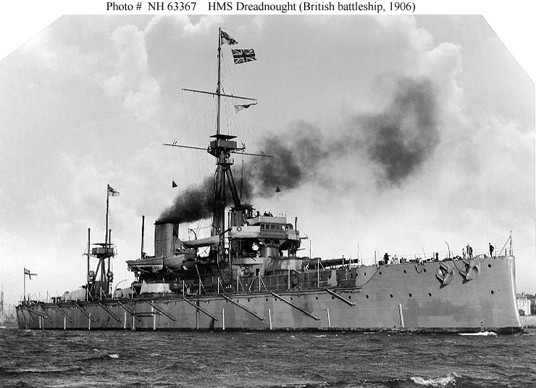
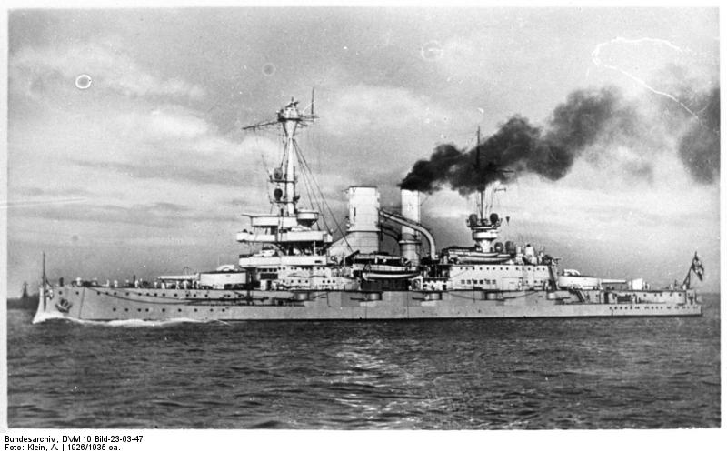
Militarism
Germany and Britain were competing to expand their dominance of the seas
Britain had introduced a battleship called the “Dreadnought "in 1906
Germany followed with their own battleships soon after
By 1914 Britain had 29 dreadnoughts to Germanys 17

Slide 22
Militarism
Russia, France and Germany also competed to expand their armies
 | 1880 | 1914
Germany | 1.3 m | 5.0 m
France | 0.73 m | 4.0 m
Russia | 0.40 m | 1.2 m

Slide 23
M-A-I-N Causes
An acronym for the 5 main causes of WW1
M: Militarism
A: Alliances
I: Imperialism
Nationalism

Slide 24
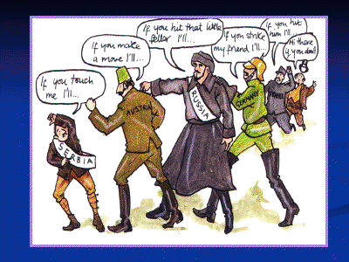
Alliances
Signed treaties in which each nation involved pledges to defend the other if attacked by an aggressor.
By 1914 all the major powers were linked by a system of alliances.
The alliances made it more likely that a war would start.
Once started, the alliances made it more likely to spread as well.
Notes:
Alliances Simulation

Slide 25
Alliances
Triple Alliance began in 1882 when Bismarck, confident that France would not attack Germany without help, signed alliances with other European powers, specifically Austria-Hungary and Italy
When WW1 erupts in 1914, this “Triple Alliance”, becomes known as the Central Powers
In 1893 a rival bloc took shape when France and Russia formed an alliance.
In 1904 France and Britain signed an “entente” – nonbinding agreement to follow common policies which led to closer military and political ties. Britain later signed a similar agreement with Russia
When WW1 erupts in 1914 the “Triple Entente”, becomes known as the Allied Powers
Note: Other treaties/alliances are also formed (Ex: Germany with Ottoman Empire and Britain with Japan)

Slide 26
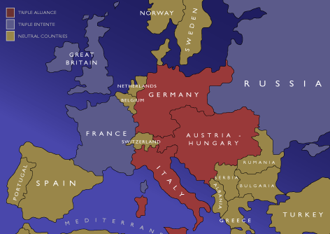
Alliances
TRIPLE ENTENTE
AKA Allied Powers
Great Britain
France
Russia
TRIPLE ALLIANCE
AKA Central Powers
Germany
Austria- Hungary
Italy

Slide 27
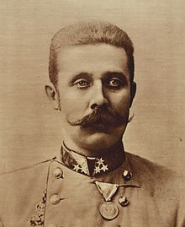
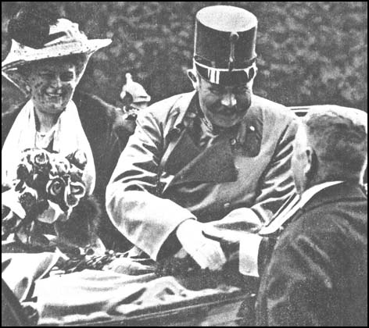
Assassination
The “Spark” that started the Great War (WW1)
June 28, 1914
Heir to the Austrian throne, Archduke Franz Ferdinand visits Sarajevo
Capital of Bosnia, recently grabbed by Austria
Hotbed of Slavic Nationalism

Slide 28
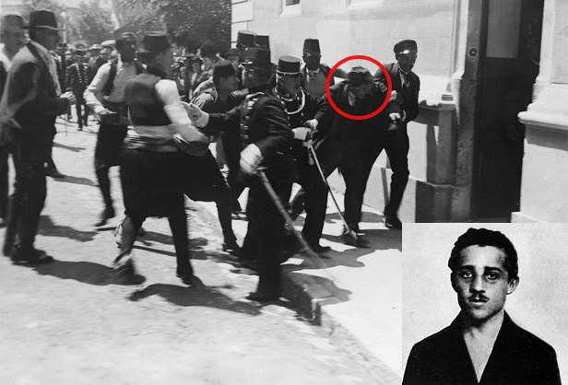
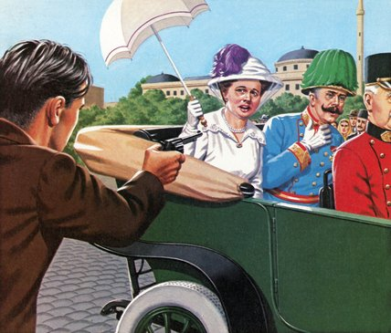
Assassination
Members of the terrorist organization “Black Hand” attack the Archduke
Gavrilo Princip shoots and kills Archduke Ferdinand and his wife Sophie
Notes:
Arch Duke Franz Ferdinand Reading

Slide 29
The Point of No Return
Austria blamed Serbia for Ferdinand’s death and for supporting terrorists
July 28: Austria declares war on Serbia
Germany pledges support for Austria
Russia pledges support for Serbia
July 30: Russia mobilizes troops to support Serbia
August 1: Germany declares war on Russia
Notes:
Willy-Nicky Letters

Slide 30
Review
World War I Jigsaw Activity

