Slide 1
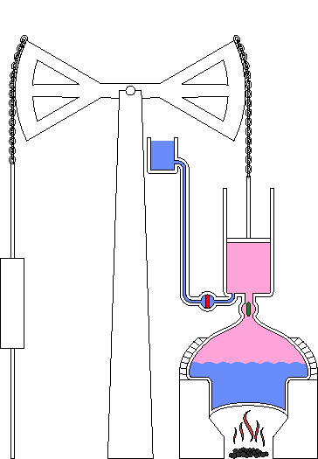
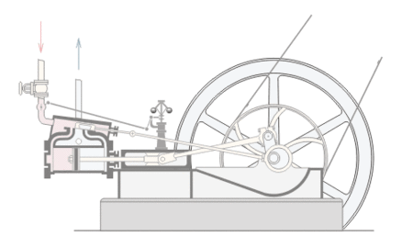
Newcomen (1712)
Watt (1788)
Interactive Steam Engine Link (Michigan State University)

