Slide 1
Welcome to Meet the Teacher
August 23, 2016 4:00-7:00

Slide 2
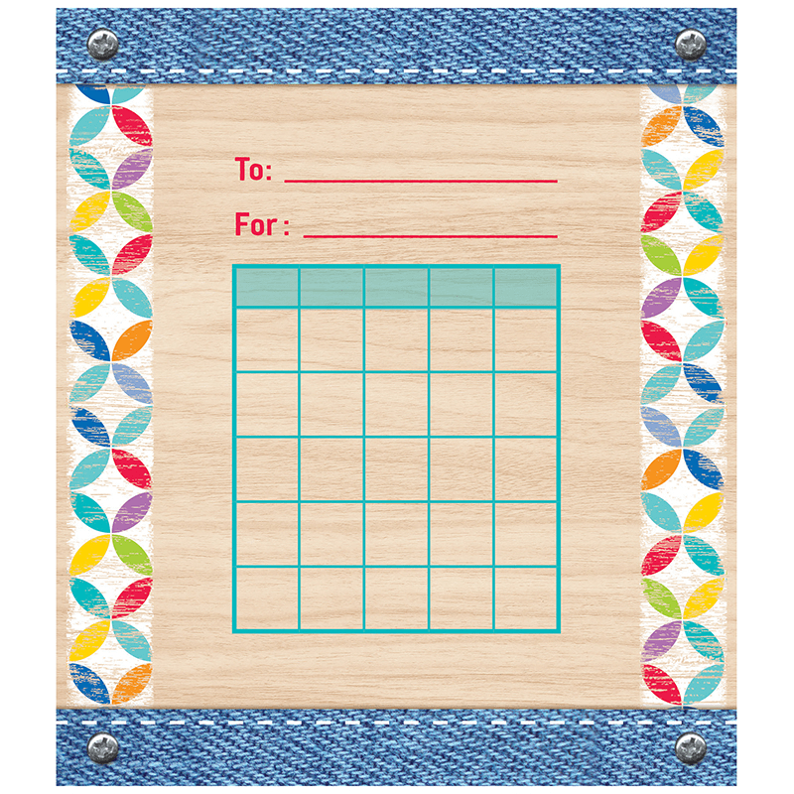
The 5th Grade Team
5H Mrs. Lynch ex4236 alylyn@hasdhawks.org
5A Mrs. Missimer ex4231 krimis@hasdhawks.org
5W Mrs. Eaton ex 4233 krieat@hasdhawks.org
5K Mrs. Crider ex4235 lorcri@hasdhawks.org
5S Miss Boyer ex4234 marboy@hasdhawks.org
LS Mr. Marra ex4237 robmar@hasdhawks.org

Slide 3
Classroom Rules:
Follow directions.
Keep hands, feet, and objects to yourself.
Respect yourself, all people, and all things.
You are responsible for your own actions.
Failure to follow the rules will result in logical consequences.

Slide 4
5th Grade’s Homework Policy
Assigned almost every day
Posted daily on classroom board, student’s responsibility to copy it.
Isn’t written in agenda? Posted daily on my teacher site at www.hasdhawks.org.
Most not graded, but completion counts.
Incomplete/Late Homework
Record kept.
Parents notified after third late assignment via email.
Completed during recess. Natural consequences for recurrences.
Homework completion/incompletion has a direct affect on test scores/report card grade.

Slide 5
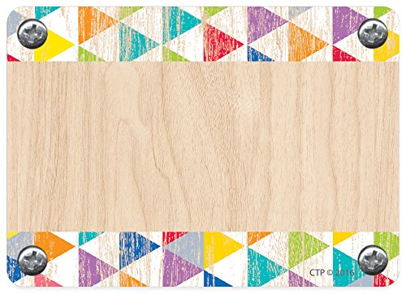
5K’s Grade’s Daily Schedule
Day A | Day B | Day C | Day D | Day E
Library 9:00-9:40 | Art 9:00-9:40 | Phys. Ed. 9:00-9:40 | Library 9:00-9:40 | Art/PE/Chorus/Tech 9:00-9:40
WIN/Title 1 9:45-10:25 | WIN/Title 1 9:45-10:25 | WIN/Title 1 9:45-10:25 | WIN/Title 1 9:45-10:25 | WIN/Title 1 9:40-10:25
Language Arts 10:25-11:15 | Language Arts 10:25-11:15 | Language Arts 10:25-11:15 | Language Arts 10:25-11:15 | Language Arts 10:25-11:15
Lunch/Recess 11:15-11:50 | Lunch/Recess 11:15-11:50 | Lunch/Recess 11:15-11:50 | Lunch/Recess 11:15-11:50 | Lunch/Recess 11:15-11:50
Language Arts 11:45-12:55 | Language Arts 11:45-12:55 | Language Arts 11:45-12:55 | Language Arts 11:45-12:55 | Language Arts 11:45-12:55
Recess 12:55-1:15 | Recess 12:55-1:15 | Recess 12:55-1:15 | Recess 12:55-1:15 | Recess 12:55-1:15
Math 1:15-2:55 | Math 1:15-2:55 | Math 1:15-1:50 Science Lab 1:50-2:35 | Math 1:15-2:55 | Math 1:15-1:50
Science/SS 2:55-3:25 | Science/SS 2:55-3:25 | Math 2:35-3:25 | Science/SS 2:55-3:25 | Science/SS 2:55-3:25
Dismissal 3:25-3:50 | Dismissal 3:25-3:50 | Dismissal 3:25-3:50 | Dismissal 3:25-3:50 | Dismissal 3:25-3:50

Slide 6
Language Arts
Wonders
Based on Common Core State Standards
Integrates
Reading
Writing
Listening/Speaking
Spelling
Built around a central weekly concept and an essential question
Whole Group Readers
Leveled Readers
Daily writing
Daily and Weekly Assessments
Curricular Integration

Slide 7
Mathematics
Homework
Assigned mostly every night
Not graded, but completion counts toward final grade
Envision Math
Place Value
Adding and Subtracting Decimals
Multiplication
Use Models and Strategies to Multiply Decimals
Use Models and Strategies to Divide Whole Numbers
Use Models and Strategies to Divide Decimals
Use Equivalent Fractions to Add and Subtract
Apply Understanding of Multiplication to Multiply Fractions
Apply Understanding of Division to Divide Fractions
Understand Volume Concepts
Convert Measurements
Represent and Interpret Data
Algebra: Write and Interpret Numerical Expressions
Graph Points on the Coordinate Plane
Algebra: Analyze Patterns and Relationships
Geometric Measurement: Classify Two-Dimensional Figures

Slide 8
Science
Examples of Concepts Covered
Cells
Laws of Motion
Ecosystems
Forms of Energy
Weekly Science Labs
STEM Activities
(science, technology,
engineering, mathematics)

Slide 9
Social Studies
Examples of Concepts Covered:
Early Explorers
Early English Colonies
Colonial America
The American Revolution
The Constitution

Slide 10
Grading
Test, quiz, and project grades will be posted online.
Possible retesting on test grades that are 75% or lower.
Reading, Social Studies, Science, and Health
Grade is calculated by the total points earned from student work.
Math
Written assessments are weighted for 85% of total grade.
Fact assessments are weighted for 10% of total grade.
Homework completion is weighted for 5% of total grade.

Slide 11
Grading
A 94-100%
B 86-93%
C 76-85%
D 70-75%
F 69% and below

Slide 12
Getting Good Grades
Work together with your child to…
Set up a routine.
Check agendas/homework site daily.
Be actively involved with each night’s homework.
Study spelling/vocab. words with your child each night.
Check for errors when completed.
Show them how to find/correct the answers.
Circle/write note for difficult items so I know about it.
Help to make sure homework is placed in backpack.

Slide 13
When Your Child Is Absent
Absent Line: Call the District phone line at 610-562-2241.
Follow the prompts given to you.
Fill out the “Excuse for Absence” card attached to homework.
also available at www.hasdhawks.org under “Parent Info”, then “Forms and Publications” so that the absence is not unexcused.
HOMEWORK
If Same Day Pick-Up, MUST call office (610-562-2241) and make request in the morning. Ready by 3:00.
Otherwise, student will pick-up homework on return
Due back same number of days absent
Unfinished work counts as late and will be completed during recess

Slide 14
Before you leave,
Afternoon Snacks
Water Bottles
Dress Code in Agendas
Clearances for volunteers
Instructions and forms on District Website
FBI Clearance takes time
Chaperones for field trip randomly chosen from the list given to us from the District Office

