Slide 1
ISIS/ISIL

Slide 2
Al-Qaeda’s “Flag of Jihad”

Slide 3
Al-Qaeda in Iraq’s Flag (AQI)

Slide 4
Islamic State of Iraq and Syria’s / Levant’s Flag (ISIS/ISIL)

Slide 5
What similarities do you notice between the flags?

Slide 6
So, what’s up with the black flags?
Taken from the Hadith, a collection of words, actions, or habits of the Prophet Muhammed
“The black flags will come from the East, led by mighty men, with long hair and beards. Their surnames are taken from the names of their home towns and their first names are from a ‘Kunya (honored person).’”
“If you see the Black Banners come from Khurasan, go to them immediately, even if you must crawl over ice, because indeed amongst them is the Caliph, Al Mahdi (THE END TIMES).”
Groups like ISIS believe their “Black Banners” will trigger the final battle between infidels and Muslims near the town of Dabiq, Syria and bring about the Day of Judgment

Slide 7
ISIS/ISIL’s Origins
1999: Abu Musab al-Zarqawi forms Jamāʻat al-Tawḥīd wa-al-Jihād (“The Organizatin of Monotheism and Jihad”)
2004: al-Zarqawi swears bayat to bin Laden, changes name to Tanzim Qaidat al-Jihad fi Bilad al-Rafidayn (unofficially known as “Al-Qaeda in Iraq”)
January, 2006: AQI joins other jihadi groups, forms the “Mujahideen Shura Council”
June, 2006: al-Zarqawi killed by JSOC in strike
October, 2006: “Mujahideen Shura Council” joins other insurgent groups, establishes ad-Dawlah al-ʻIrāq al-Islāmiyah (Islamic State of Iraq)
April, 2010: ISI’s leaders, Abu Ayyab al-Masri and Abu Omar al-Baghdadi killed in a raid near Tikrit; Abu Bakr al-Baghdadi becomes leader

Slide 8
ISIs/ISIL’s origins
Spring, 2011: “Arab Sping” comes to Syria, civil war breaks out
Sunni majority revolting against dictator Bashar al-Assad and his Shia minority
Baghdadi sends his forces to help in the revolt
June, 2013: Tension between al-Qaeda and ISI
Al-Zawahiri and al-Qaeda supporting the al-Nusra Front; want ISI in Iraq only
Baghdadi and his ISI forces reject this
February, 2014: Al-Zawahiri kicks ISI out of al-Qaeda
June, 2014: ISI captures Mosul (and the American equipment held at the base there), al-Baghdadi announced group name change to Islamic State of Iraq and Syria and the establishment of a caliphate (Islamic empire)- DIRECT challenge to al-Qaeda and other terrorist groups

Slide 9
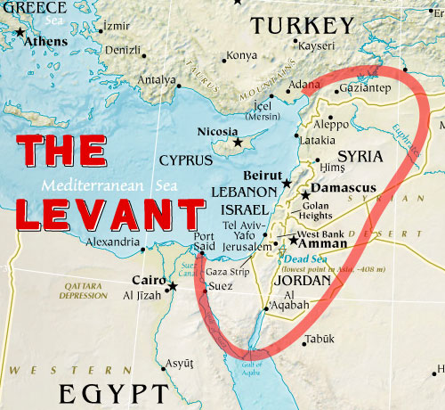
The Name
ISIS: Islamic State of Iraq and Syria
ISIL: Islamic State of Iraq and the Levant (all of the eastern Mediterranean Sea)

Slide 10
Abu Bakr al-Baghdadi
Very little known about his personal life
Believed to be born in 1971
Believed to be born in Samarra, near Baghdad
Has a doctorate for Islamic studies in Quranic studies
Highly organized and intelligent
Arrested in Fallujah, February 2004
Given access to up to 20,000 inmates at Camp Bucca; de facto terrorist university?
Released in December 2004 as a “low level prisoner”

Slide 11
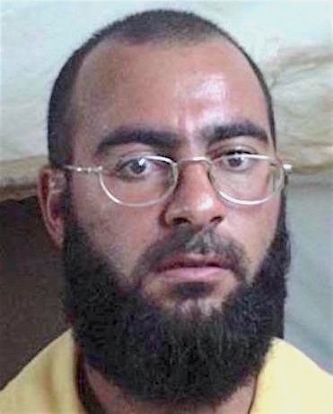
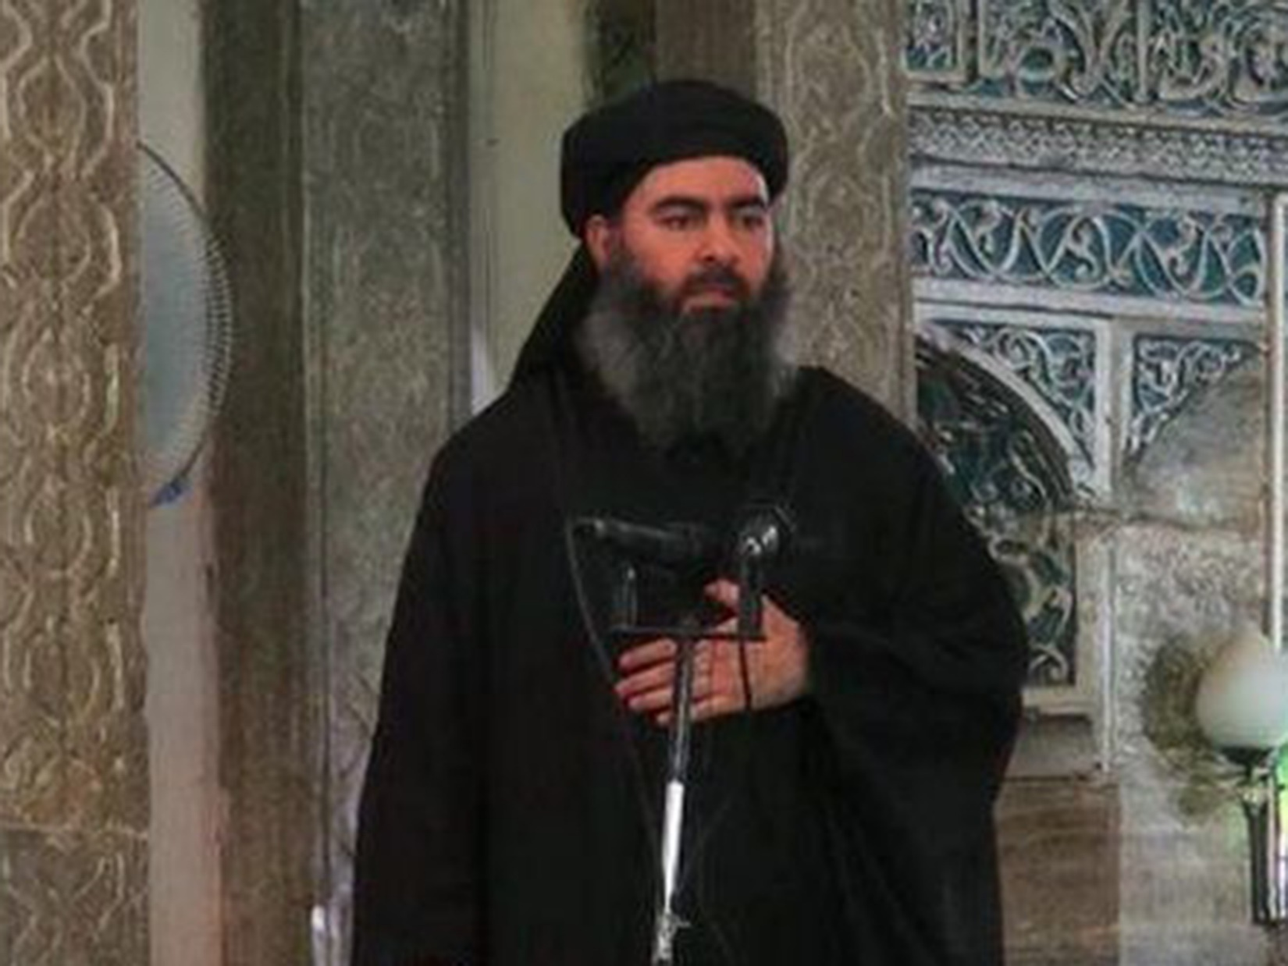

Slide 12
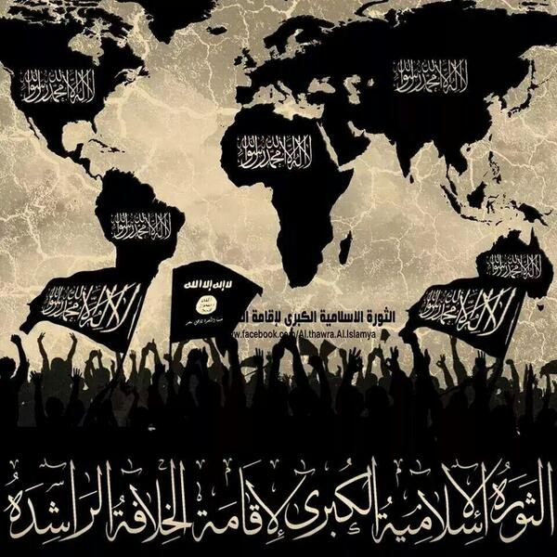
ISIS/ISIL’s Goal and Strategy
Goal
Establish a Sunni Islamic State
Eventually conquer the world and establish a global caliphate
Target Muslim lands first
Following that, non-Muslim lands
Strategies
Drive wedges between Muslims and non-Muslims in countries; drive the Muslims towards ISIS/ISIL
Use extreme tactics to scare all non-ISIS/ISIL supporters

Slide 13
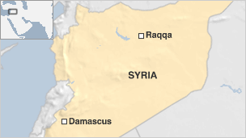
ISIS/isil’s Government
Capital is Raqqa, in Syria
Al-Baghdadi assisted by a cabinet of advisors
Local governors control smaller territories in held territory
Shura council makes sure they follow the Quran (their interpretation of it)
Economy
Control of banks, oil and gas reservoirs, taxes, extortion, and robbery
Kidnappings
“Charity” from other countries
Support from fighters
Fundraising through social networks

Slide 14
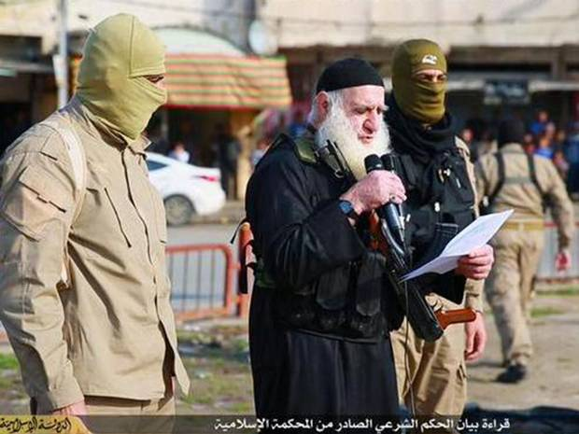
Life in the Islamic State
Women oppressed
Must always be covered from head to toe
Many forced as “brides”
Non-Muslims are considered fair game for rape
Education
Sharia based
No art, music, evolution, national history, literature, Christianity
Minority groups oppressed
Homosexuality punishable by death
Yazidi Christians specifically targeted
Non-Muslims forced to convert or pay high tax
Religious police wander cities enforcing policies
Seek to erase non-Muslim history and cultural history
Leadership hides near civilians (human shields)

Slide 15
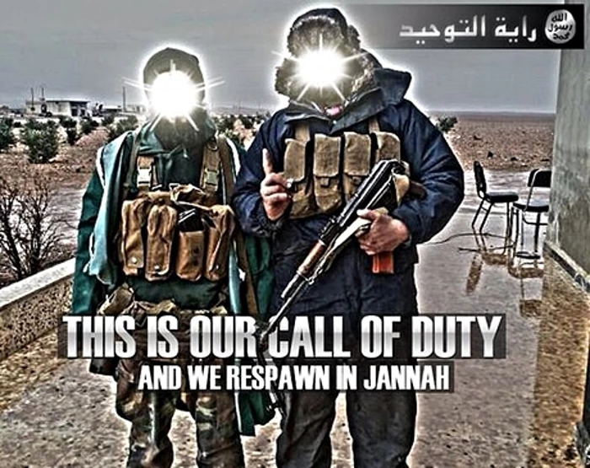
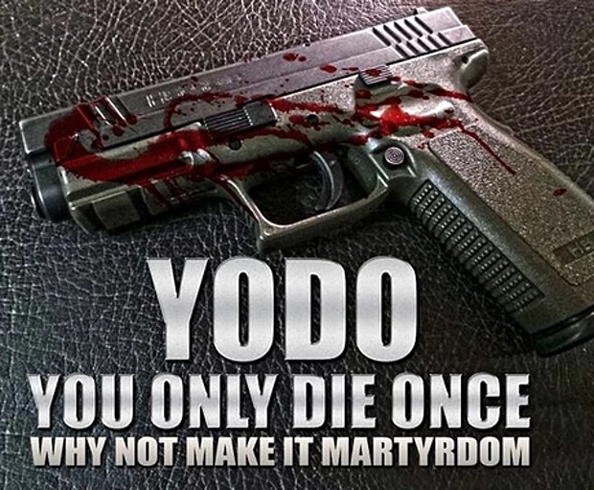
ISIS/ISIL’s Propaganda
Publishes a magazine, Dabiq
Runs a radio network, Al-Bayan
Social Media
Twitter mainly
Other social media that is harder to track
Goal of propaganda
Reach out to alienated youth
Specifically Western Muslims
Propaganda slicker and more professional looking than that of other jihadi groups

Slide 16
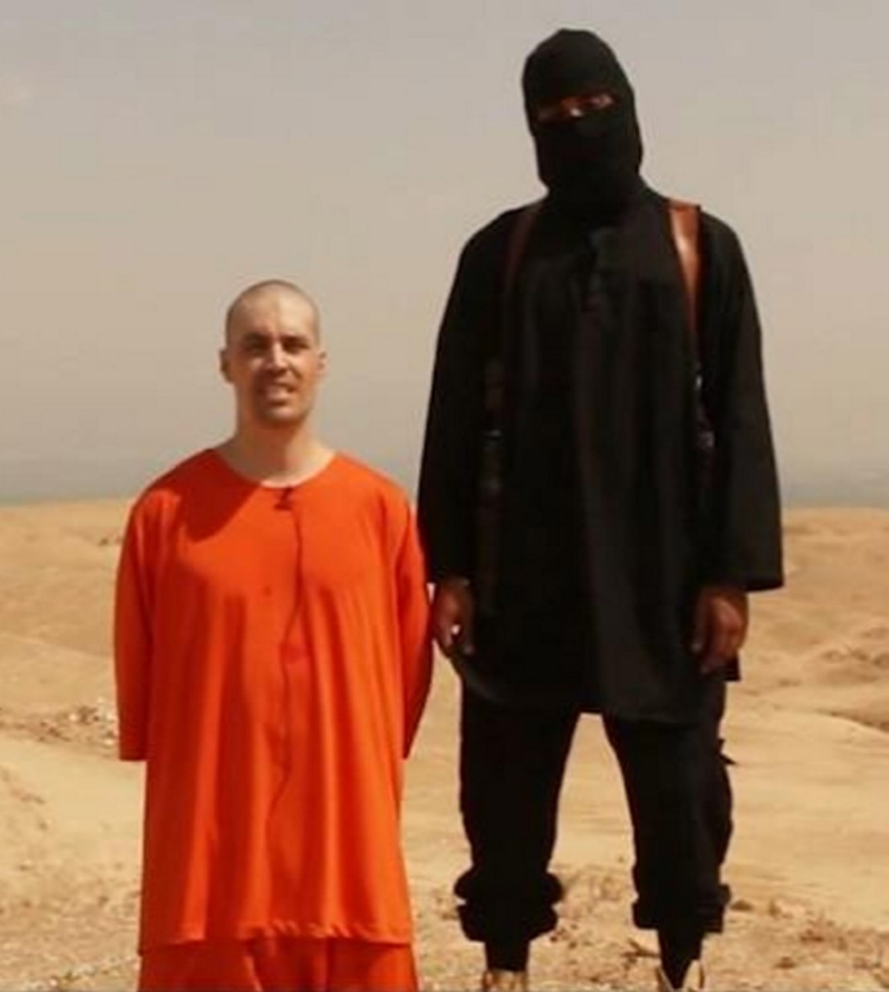
“Jihadi John”
Real name: Mohammed Emwazi
Born in Kuwait, moved to U.K. at 6
Radicalized some time in his late teens
Symbolic of the European struggle with Islamic radicalization
Became the visual symbol of ISIS and their atrocities
Killed in a drone strike, November 12, 2015

Slide 17
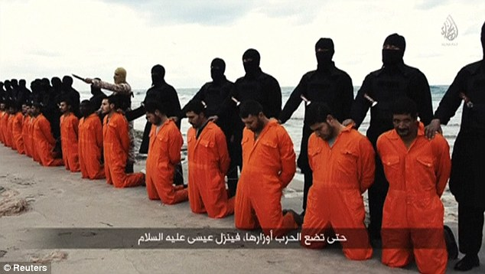
Isis/ISIL going global
Use of shocking videos on internet to keep name known globally
Beheadings
Being thrown off buildings
Being burned alive
Drownings
Shootings
Other groups have pledged bayat to ISIS/ISIL
Seeks to inspire “lone wolf” sympathizers to conduct attacks on the West
Paris, France
San Bernadino, California
Brussels, Belgium

Slide 18
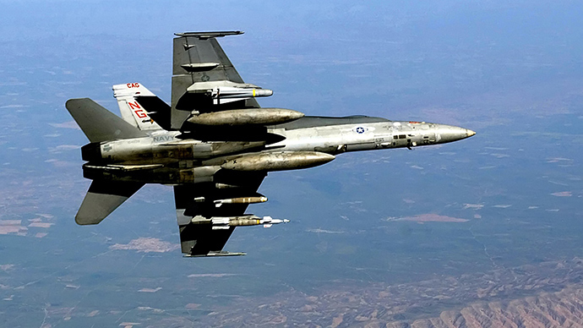
The United States’ Response to ISIS/ISIL
Military aid to the Kurds
Airstrikes
Drones
Military Advisers
Arming and training “moderate” rebel forces in Syria

Slide 19
Abu Bakr Al-Baghdadi: The Man Who Drew The U.S. Back to Iraq
Head of ISIS, Abu Bakr al-Baghdadi's Year in Review

Slide 20
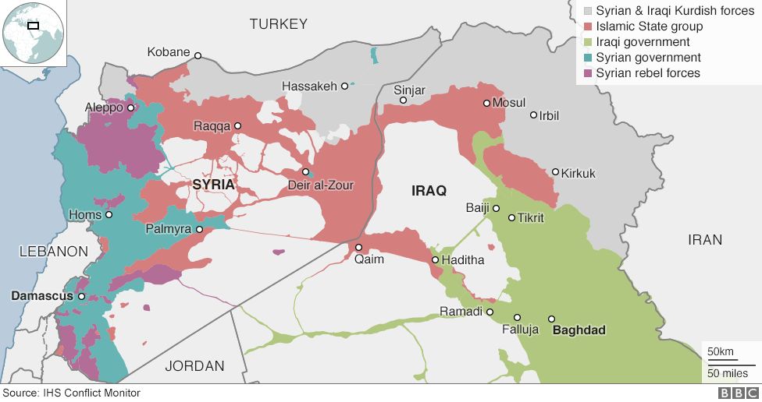
ISIs/ISIL Held Territory (August 2016)

